Slide 1
TEACHINGS AND DOCTRINE OF THE BOOK OF MORMON
Living Righteously in a Day of Wickedness

Slide 2
The Book of Mormon records the destruction of individuals and societies that embraced wickedness and allowed secret combinations to exist. At the same time, the Book of Mormon also teaches that we can live righteously despite living in a wicked environment. We should look for and identify ways we can remain righteous in today’s world.

Slide 3
Readings
Quentin L. Cook, “Reaping the Rewards of Righteousness,” Ensign, July 2015, 33–39.
Dennis B. Neuenschwander, “One among the Crowd,” Ensign, May 2008, 101–3.

Slide 4
Principles
Secret combinations can destroy freedoms, governments, and societies.
We can live righteously even when we are surrounded by wickedness.
If we have faith in Christ and in His Atonement, then we will have the strength to live righteously despite being surrounded by wickedness.

Slide 5
Enemy Territory
Notes:
Write the phrase enemy territory on the board and ask students what it means.
Why does Satan want to hurt us?

Slide 6
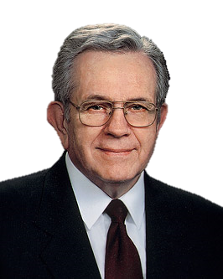
President Boyd K. Packer
You young people are being raised in enemy territory. We know from the scriptures that there was a war in heaven and that Lucifer rebelled and, with his followers, ‘was cast out into the earth’ [Revelation 12:9]. He is determined to disrupt our Heavenly Father’s plan and seeks to control the minds and actions of all.
“Counsel to Youth,” Ensign, Nov. 2011, 16
Notes:
In what ways is living at this time like being in enemy territory?
Explain that this lesson will examine the Book of Mormon’s description of the wicked environment in which some righteous individuals lived. Invite students to look for principles and doctrines that they can apply as they study the examples of individuals who remained faithful despite being surrounded by wickedness.
Remind students that Moroni witnessed the destruction of the entire Nephite civilization. He described the wickedness that led to both the Nephites’ and the Jaredites’ destruction. Invite a student to read Ether 8:18 and 21 aloud while the class identifies the cause of this destruction. Invite students to share what they discover.

Slide 7
What are secret combinations?
What are their goals and purposes?
How do they ensure their continued existence?
Alma 37:21–22, 25–27
Helaman 6:20–26
Ether 8:18–26
Notes:
Ask students to read one of the passages on the board and look for answers to the questions listed. Tell students that the passage they choose might not answer all three of these questions, but they should find what they can. After sufficient time, discuss the questions on the board as a class. Then discuss the following:
From what you read, what are the consequences of allowing secret combinations to exist and flourish? (Students should identify the following principle: Secret combinations can destroy freedoms, governments, and societies.)
What do you think are some examples of secret combinations in our day?

Slide 8
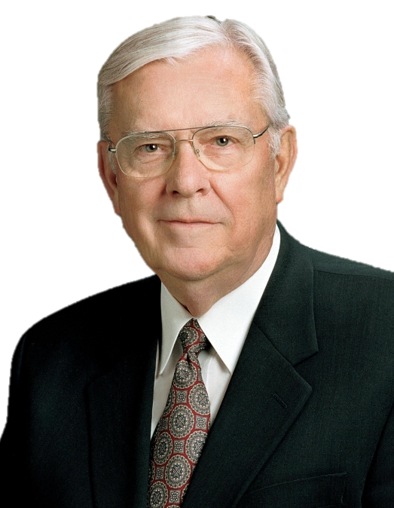
President M. Russell Ballard
Among today’s secret combinations are gangs, drug cartels, and organized crime families. The secret combinations of our day function much like the Gadianton robbers of the Book of Mormon times. … Among their purposes are to ‘murder, and plunder, and steal, and commit whoredoms and all manner of wickedness’ [Helaman 6:23]
“Standing for Truth and Right,” Ensign, Nov. 1997, 38
Notes:
If I could get everyone to buy a can of soda from me I would be wealthy. But if I could get everyone to buy a can of soda everyday for the rest of their lives I would be really wealthy.
If I could get everyone to look at my website I would be wealthy. But if I could get everyone to look at my website several times a day I would be really wealthy.
It’s just good business. Power and Gain.

Slide 9
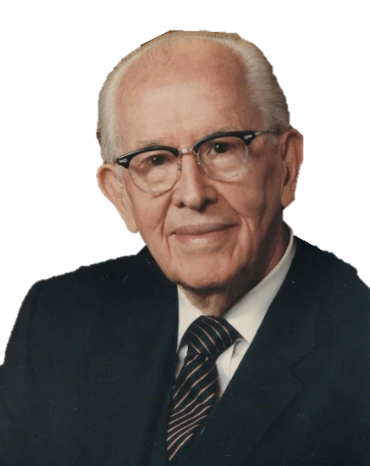
President Ezra Taft Benson
I testify that wickedness is rapidly expanding in every segment of our society. (See D&C 1:14–16; 84:49–53.) It is more highly organized, more cleverly disguised, and more powerfully promoted than ever before. Secret combinations lusting for power, gain, and glory are flourishing. … (See Ether 8:18–25.)
Ezra Taft Benson, “I Testify,” Ensign, Nov. 1988, 87
Notes:
Why do you think Book of Mormon prophets included information about secret combinations in their record?
Invite a student to read Helaman 6:20, 37–40 aloud. Have the class follow along, looking for contrasts between the Lamanites and the Nephites. (Note: Comparing and contrasting is a scripture study skill that you might emphasize in this lesson [see Gospel Teaching and Learning: A Handbook for Teachers and Leaders in Seminaries and Institutes of Religion (2012), 22].)
What can we learn from these verses about how to eliminate wickedness and secret combinations?

Slide 10
Mormon’s environment
Mormon 1:13–14, 16–17, 19; 2:8, 14–15, 18
Notes:
Tell students that the prophet Mormon was born into the environment of increasing wickedness brought on by these secret combinations. Ask students to study the following passages and look for and mark descriptions of Mormon’s environment: Mormon 1:13–14, 16–17, 19; 2:8, 14–15, 18. Invite students to report on what they found, and then ask:
What concerns would you have about living in such an environment?
Invite a student to read Mormon 1:15 and 2:19 aloud.
What can we learn from Mormon’s example during this wicked time? (As students respond, write this truth on the board: We can live righteously even when we are surrounded by wickedness.)
Give students time to read Mormon 3:2–3, 12, 22 to see what else they can learn about how Mormon was able to live righteously in a time of wickedness. After students share what they learned about Mormon, ask the following questions:
Who else in the Book of Mormon is an example of living righteously while surrounded by wickedness? (Answers might include Ether, Moroni, Abish, and the people who believed that Christ would be born, as recorded in 3 Nephi 1.)
What challenges do we face as we strive to live righteously in a wicked world?
Remind students that Mormon’s son, Moroni, lived during this same time of widespread wickedness. Before his death, Mormon wrote a letter to Moroni that is recorded in Moroni 9. Ask a student to read Moroni 9:6, 22, 25–26. Invite the class to consider how Mormon’s counsel in these verses could help us to live righteously in a wicked world.
What can we learn from these verses that will help us live righteously in today’s world? (Help students to understand the following principle: If we have faith in Christ and in His Atonement, then we will have the strength to live righteously despite being surrounded by wickedness.)
What examples have you seen of someone living righteously in the midst of today’s wickedness?
How has focusing on Jesus Christ and His Atonement helped you to rise above wicked or difficult conditions?

Slide 11
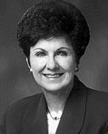
Virginia U. Jensen
“To maintain a firm stance for ourselves and help others stand firm, the message of the restored gospel must be firmly planted in our hearts and taught in our homes. … Teach your loved ones how to draw upon the powers of heaven through fasting and prayer. Teach them that keeping the Sabbath day holy will insulate them from the world. Teach them to be obedient. Teach them to seek God’s approval, not man’s.

Slide 12
Virginia U. Jensen
Teach them that the only route back to our heavenly home is by loving and following the Savior and by making and keeping sacred covenants and commandments. The truths of the gospel and knowledge of the plan of salvation are weapons your family members can use for victory over Satan’s evil forces
“Stand Firm,” Ensign, Nov. 2001, 94
Notes:
What has given you determination and strength to be obedient to the Lord in an increasingly wicked world?
Explain that during the long war between the Nephites and Lamanites recorded in the book of Alma, individuals had to stand against forces of evil in order to preserve their lives. Invite students to study Alma 62:41 and look for the contrasting ways in which individuals responded to adversity and wickedness. Invite students to share what they discovered that could help them live righteously in a wicked world.

Slide 13
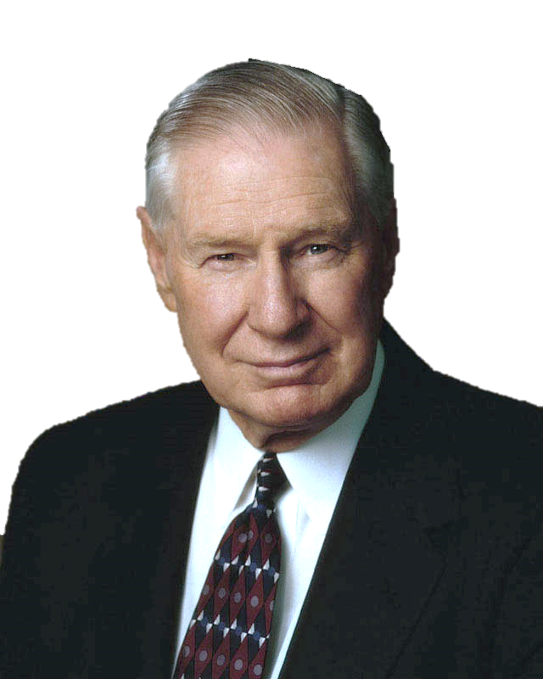
President James E. Faust
“In an increasingly unjust world, to survive and even to find happiness and joy, no matter what comes, we must make our stand unequivocally with the Lord. We need to try to be faithful every hour of every day so that our foundation of trust in the Lord will never be shaken. …

Slide 14
President James E. Faust
“It’s not so much what happens to us but how we deal with what happens to us. That reminds me of a passage from Alma. After a long war ‘many had become hardened,’ while ‘many were softened because of their afflictions’ [Alma 62:41]. The same circumstances produced opposite responses. … Each of us needs to have our own storehouse of faith to help us rise above the troubles that are part of this mortal probation”
“Where Do I Make My Stand?” Ensign, Nov. 2004, 18, 20
Notes:
Ask students to take a few minutes to write responses to the following question:
What commitments have you made to stand “unequivocally with the Lord”?
Then encourage students to ponder the following questions:
What promptings have you received from the Spirit concerning how you can be more committed to the Lord?
What can you do to help your family members be more committed to the Lord?
Testify that as we persevere in faith, the Lord will bless us and help us live righteously in the midst of wickedness.

Slide 15
All the water in the world,
However hard it tried,
Could never sink the smallest ship
Unless it [gets] inside.
And all the evil in the world,
The blackest kind of sin,
Can never hurt you the least bit
Unless you let it in.
Author unknown, Best-Loved Poems of the LDS People,
ed. Jack M. Lyon and others (1996), 302.

Slide 16
A just man decided he must save humanity. So he chose a city, the most sinful of all cities. Then he studied. He learned all the art of moving people, changing minds, changing hearts. He came to a man and woman and said, "Don't forget that murder is not good, it is wrong." In the beginning, people gathered around him. It was so strange, somewhat like a circus. They gathered and they listened. He went on and on and on.
Days passed. Weeks passed. After a while, they stopped listening. After many years passed, a child stopped him and said, "What are you doing? Don't you see nobody is listening? Why do you continue shouting and shouting? Why?"
And the man answered the child, "I'll tell you why. In the beginning, I was convinced that if I were to shout loud enough, they would change. Now I know they won't change. But if I shout even louder, it's because I don't want them to change me.“
Elie Wiesel

Slide 17
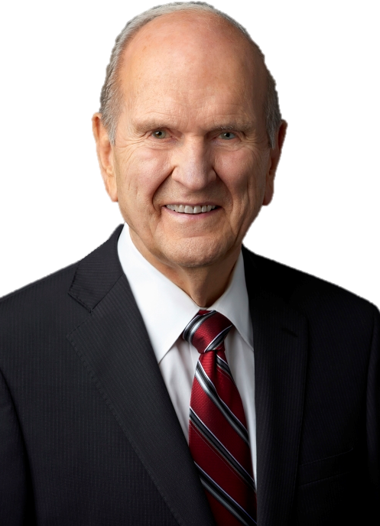
President Russell M. Nelson

Slide 18
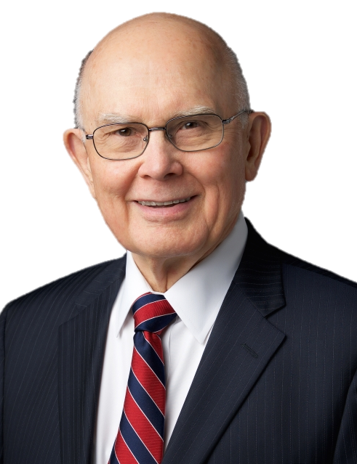
President Dallin H. Oaks

Slide 19
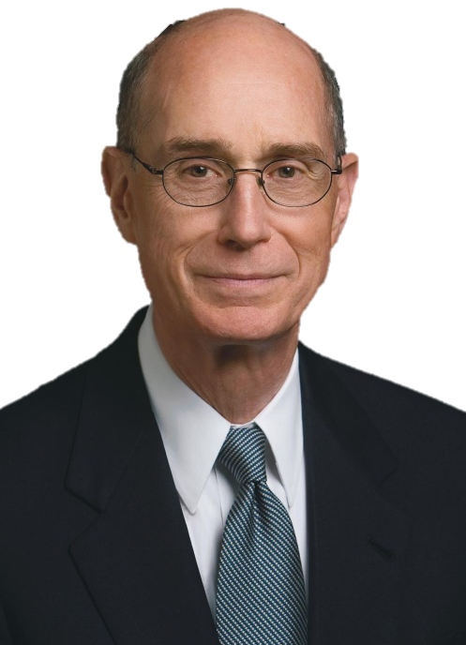
President Henry B. Eyring

Slide 20
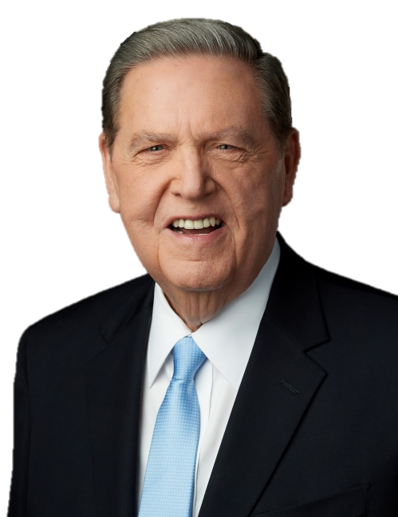
Elder Jeffrey R. Holland

Slide 21
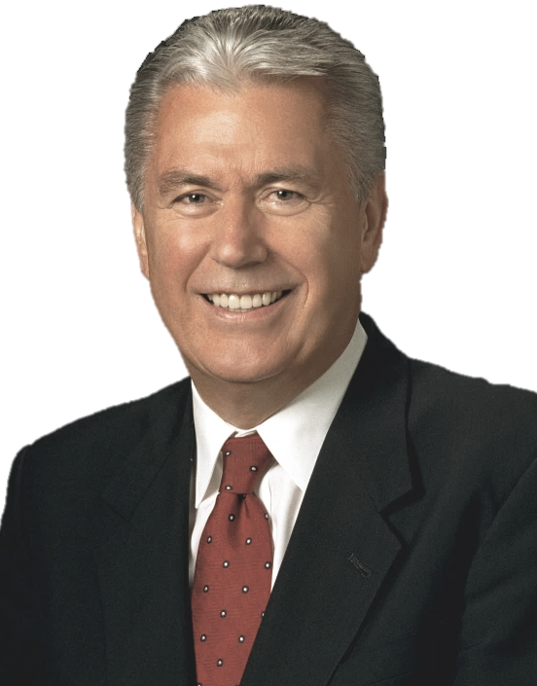
Elder Dieter F. Uchtdorf

Slide 22
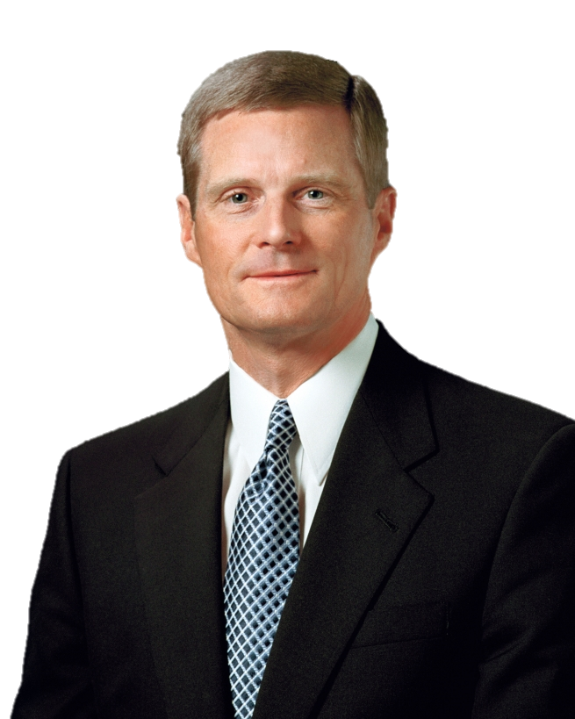
Elder David A. Bednar

Slide 23
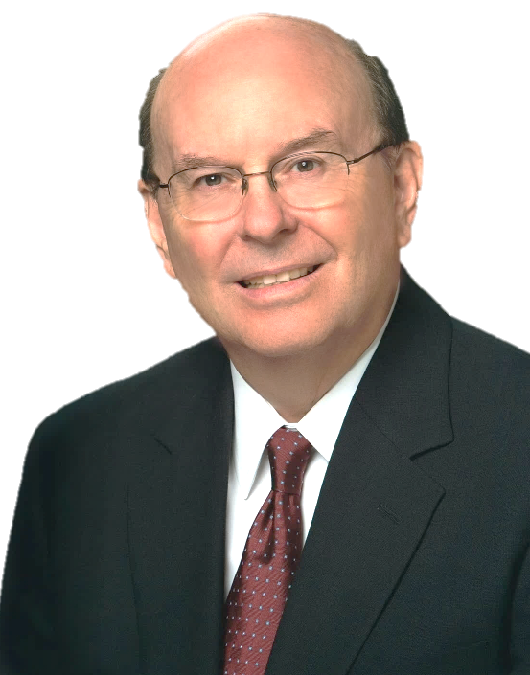
Elder Quentin R. Cook

Slide 24
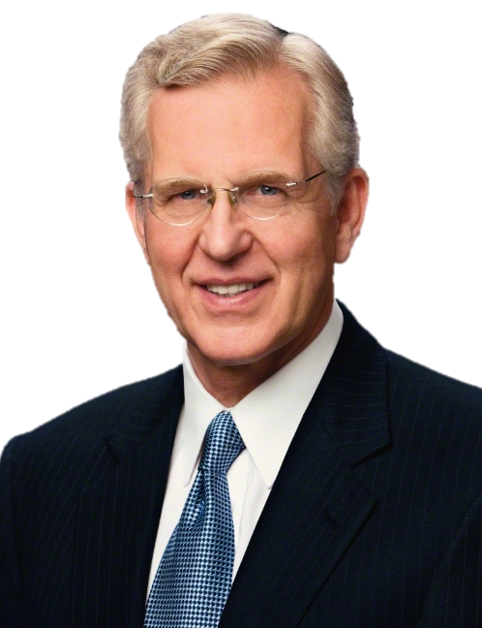
Elder D. Todd Christofferson

Slide 25
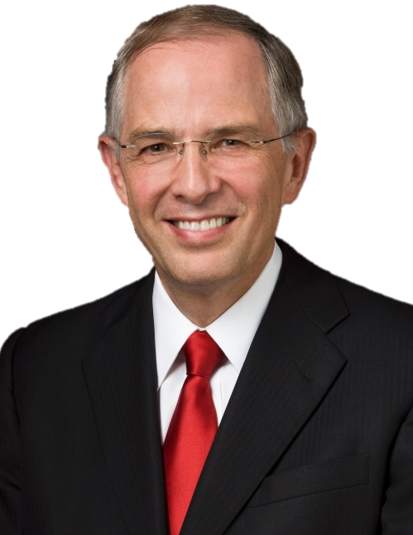
Elder Neil L. Andersen

Slide 26
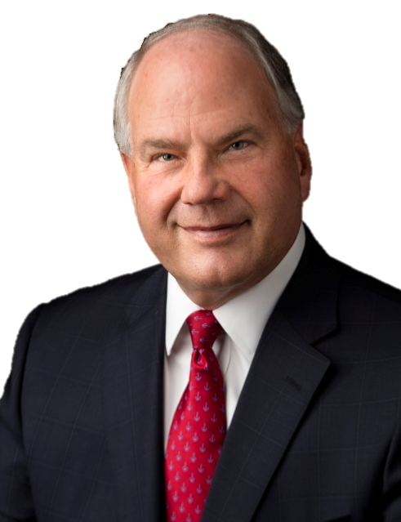
Elder Ronald A. Rasband

Slide 27
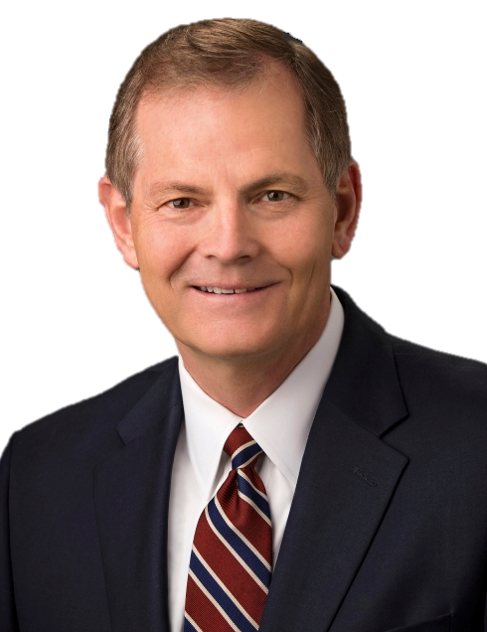
Elder Gary E. Stevenson

Slide 28
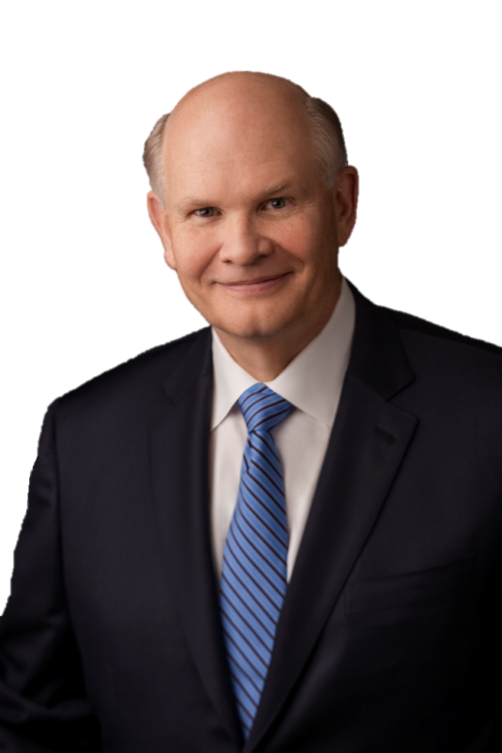
Elder Dale G. Renlund

Slide 29
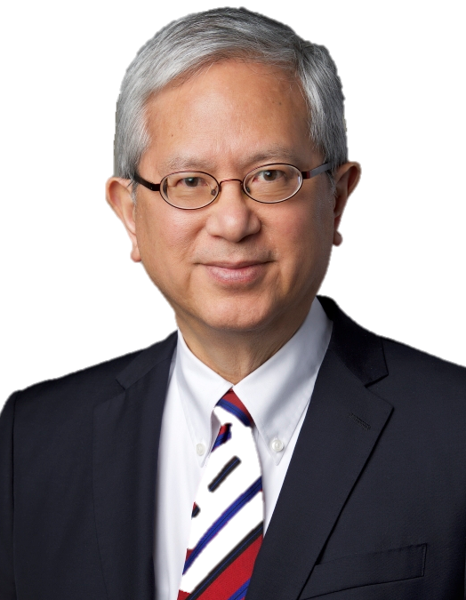
Elder Gerrit W. Gong

Slide 30
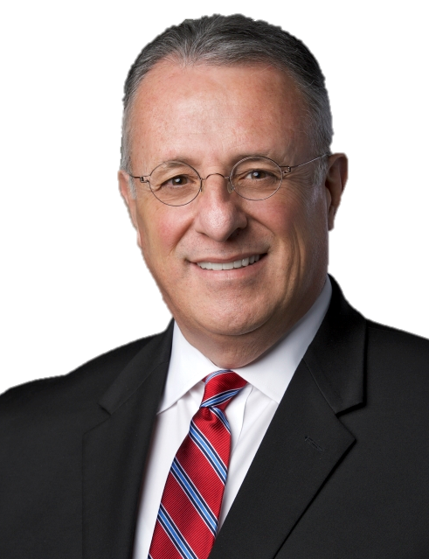
Elder Ullisses Soares

Slide 31
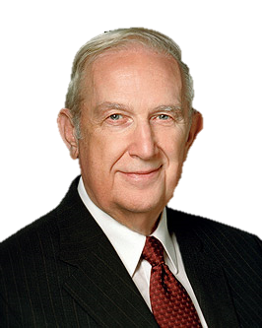
Elder Richard G. Scott

Slide 32
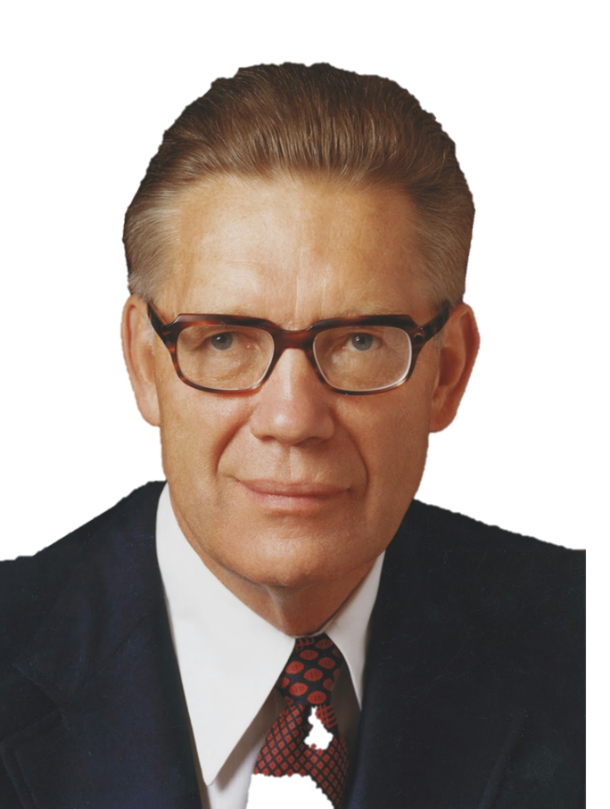
Elder Bruce R. McConkie

Slide 33
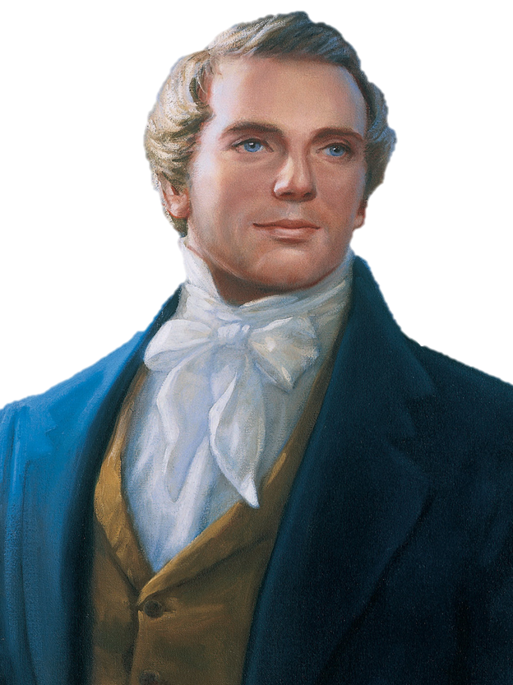
Joseph Smith

Slide 34
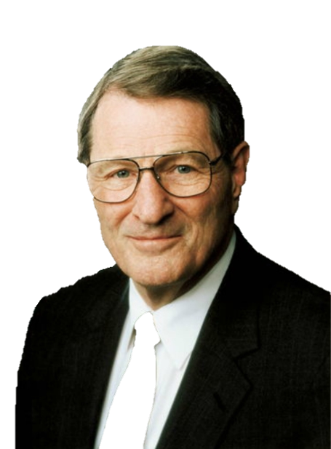
Elder Neal A. Maxwell

Slide 35
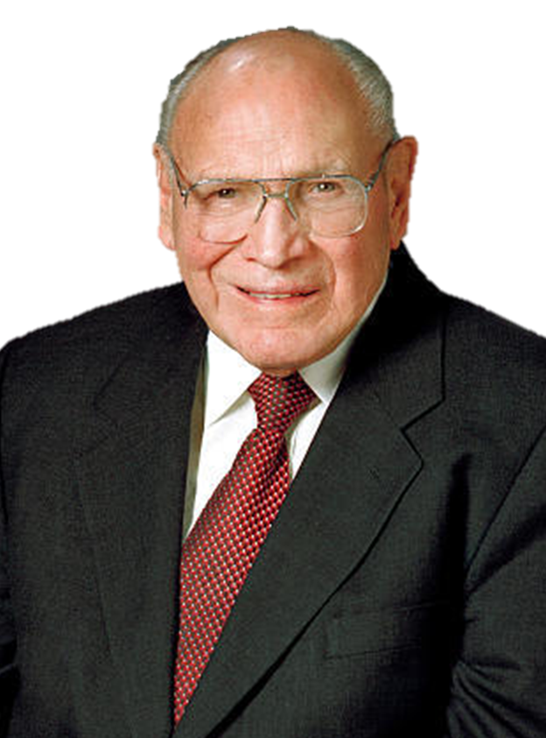
Elder Joseph B. Wirthlin

Slide 36
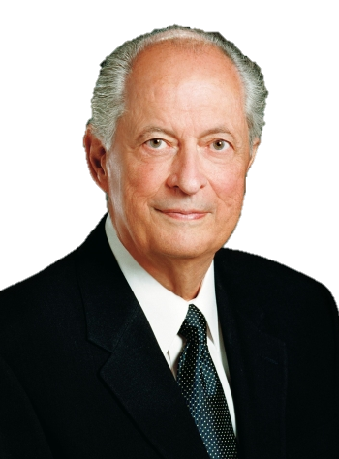
Elder Robert D. Hales

Slide 37
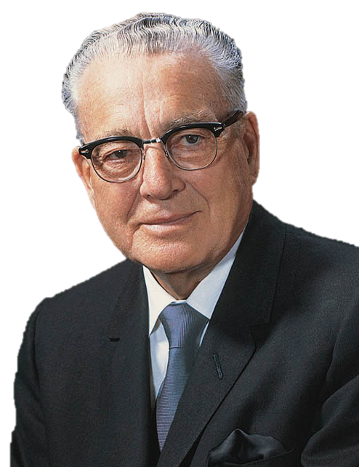
President Harold B. Lee

Slide 38
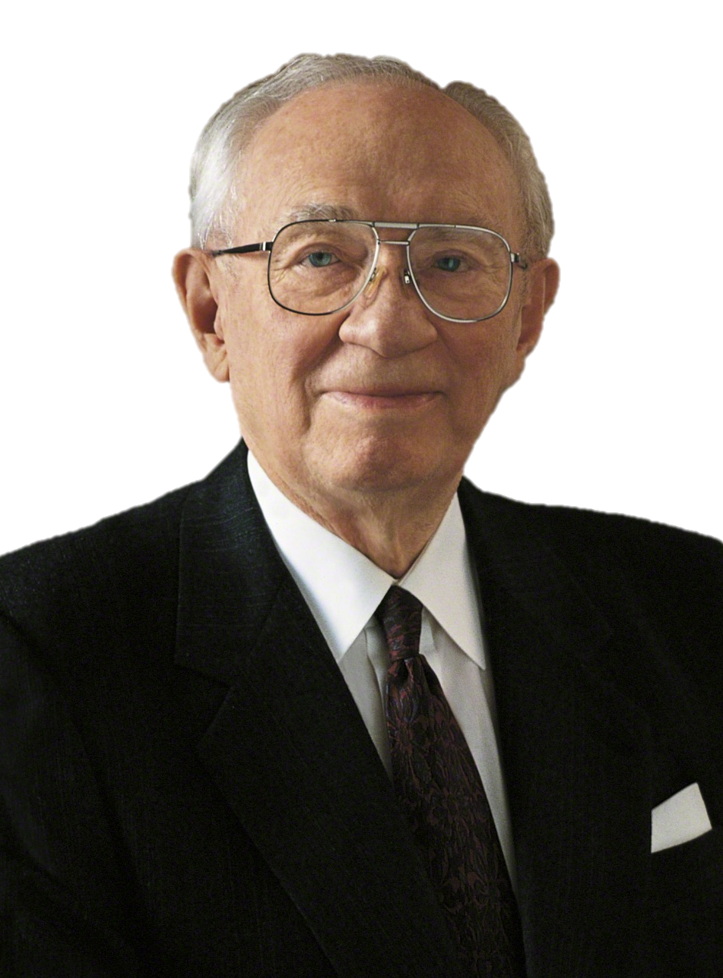
President Gordon B. Hinckley

Slide 39
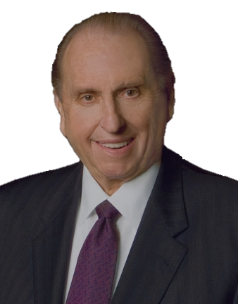
President Thomas S. Monson
Notes:
Why did Amulek warn us not to procrastinate the day of our repentance?

Slide 40
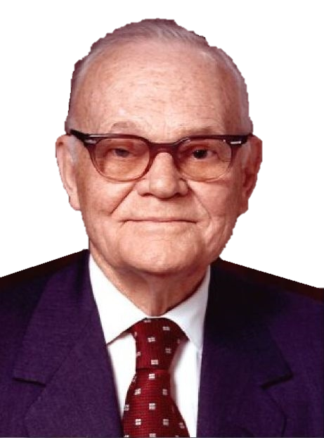
President Marion G. Romney

Slide 41
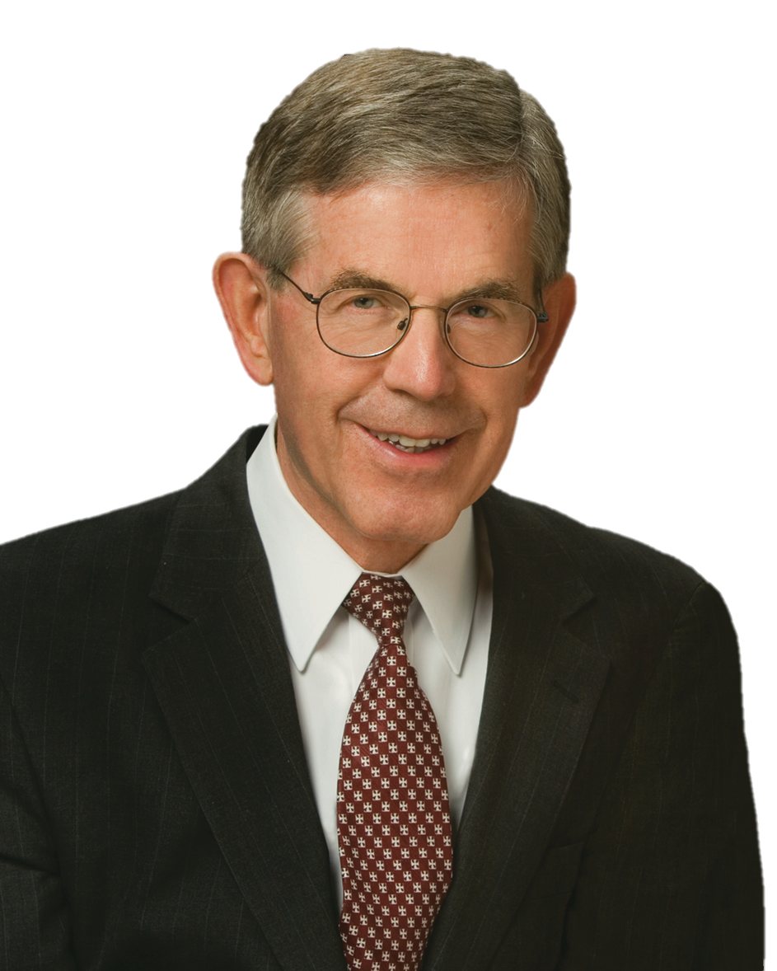
Elder Bruce C. Hafen

Slide 42
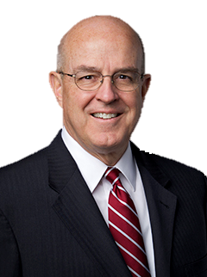
Elder Whitney L. Clayton

Slide 43
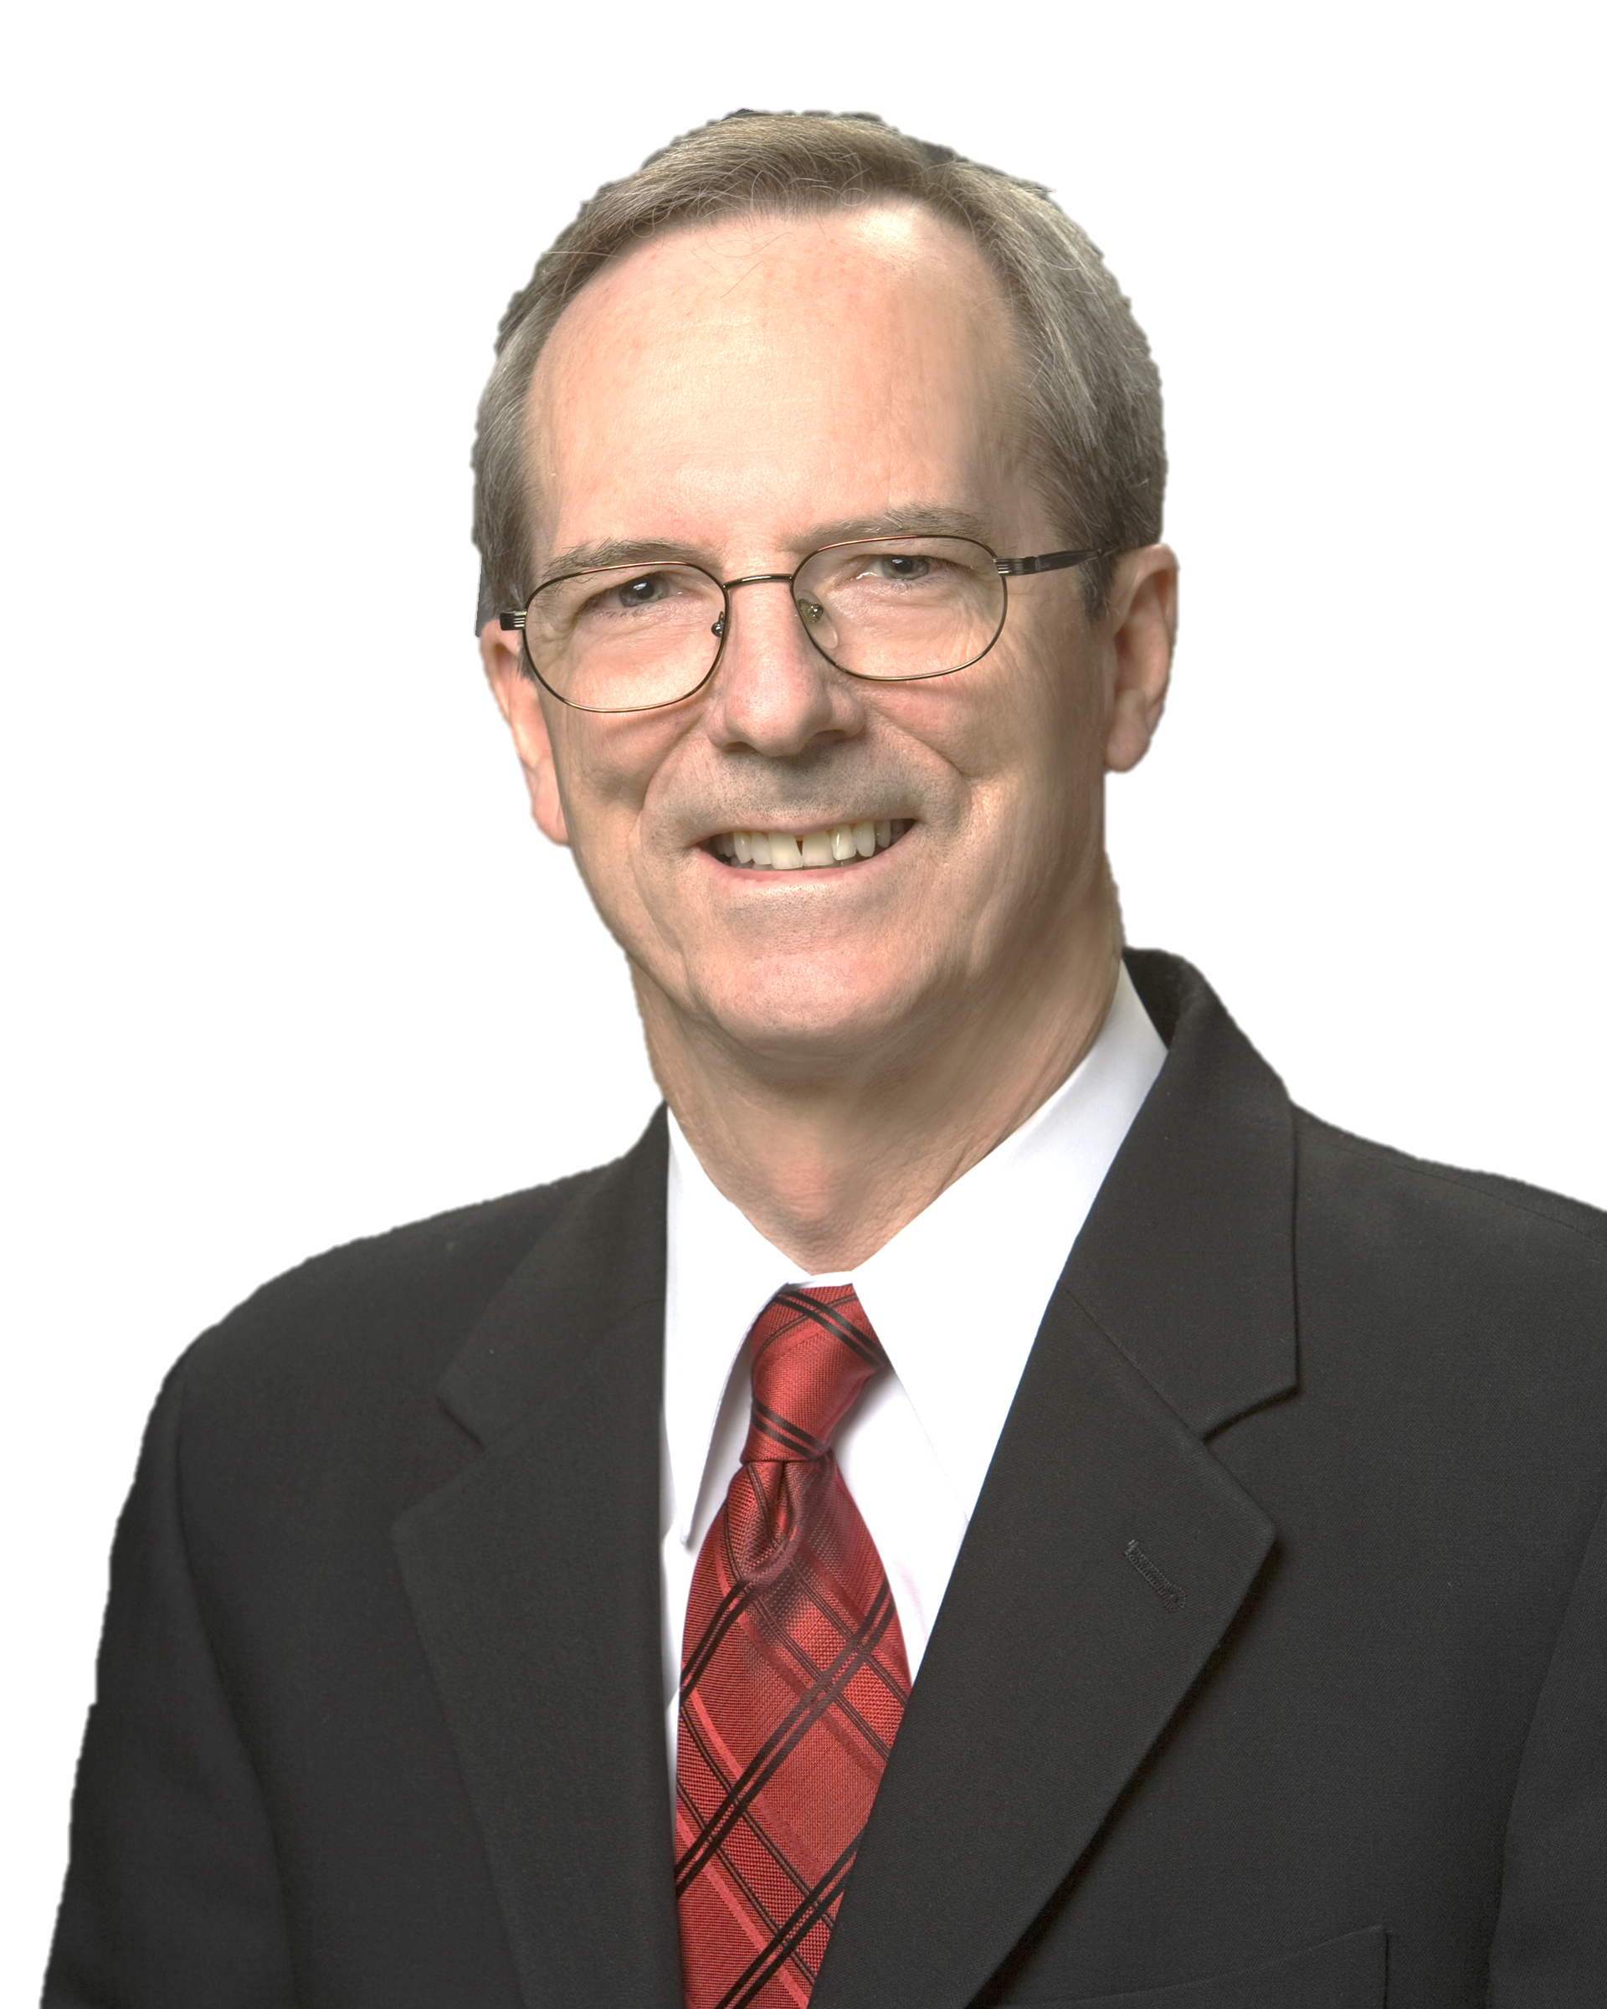
Elder Tad R. Callister

Slide 44
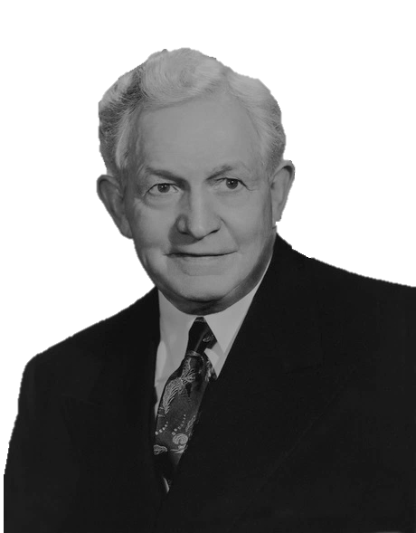
President David O. McKay
Notes:
Remind students that for centuries after Lehi arrived in the promised land, the Nephites were ruled by kings. King Mosiah, however, proposed that a new form of government be instituted. Ask students to study Mosiah 29:10–11, 16–18, 25–26 and look for why Mosiah proposed a new form of government.
What reasons did King Mosiah give for desiring to implement a new form of government?
Explain to students that the system of judges was appropriate and necessary to preserve freedom in Nephite society. Other societies have similarly sought to establish and preserve freedom, although their systems of government may have been organized differently. Ask a student to read Mosiah 29:32 aloud while the class looks for why Mosiah wanted to preserve his people’s liberty.
Why was it necessary to preserve the Nephites’ liberty?
Whose responsibility is it to help preserve our rights and privileges? How can this preservation be accomplished?
Explain that exercising individual freedoms should not supersede the principle of obeying laws of the land.
Invite students to search Alma 30:7–9 and identify one of the rights guaranteed by the new Nephite government.
You might explain that this passage shows that the Lord forbids discriminating against others based on their belief or nonbelief in God (see also D&C 134:4).
How does protecting religious freedom benefit society?

