Slide 2
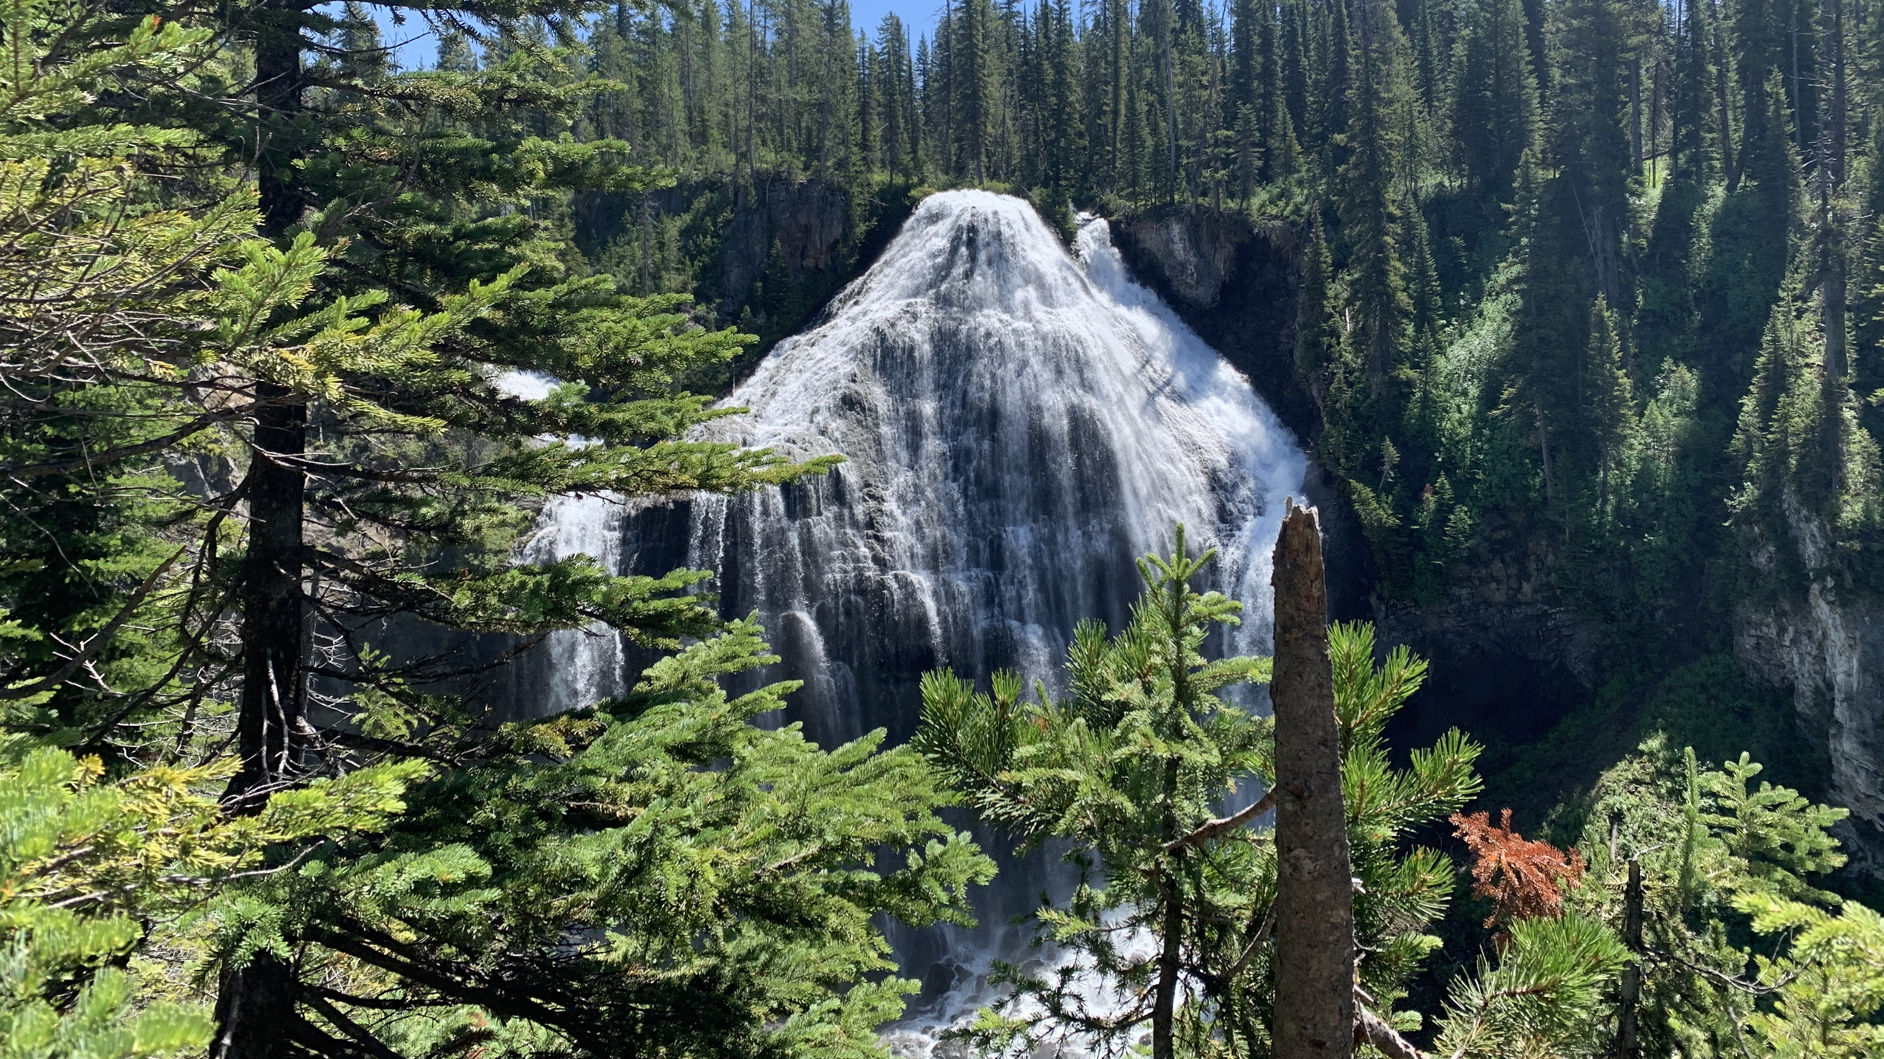

Slide 3
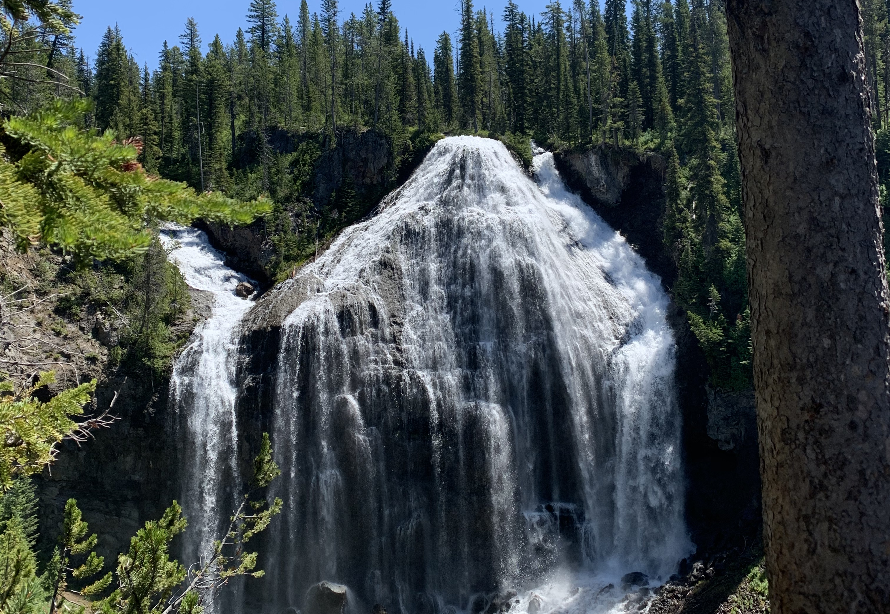

Slide 4
Doctrine and Covenants Section 77
6 Q. What are we to understand by the book which John saw, which was sealed on the back with seven seals?
A. We are to understand that it contains the revealed will, mysteries, and the works of God; the hidden things of his economy concerning this earth during the seven thousand years of its continuance, or its temporal existence.
7 Q. What are we to understand by the seven seals with which it was sealed?
A. We are to understand that the first seal contains the things of the first thousand years, and the second also of the second thousand years, and so on until the seventh.

Slide 5
Doctrine and Covenants Section 77
6 Q. What are we to understand by the book which John saw, which was sealed on the back with seven seals?
A. We are to understand that it contains the revealed will, mysteries, and the works of God; the hidden things of his economy concerning this earth during the seven thousand years of its continuance, or its temporal existence.
7 Q. What are we to understand by the seven seals with which it was sealed?
A. We are to understand that the first seal contains the things of the first thousand years, and the second also of the second thousand years, and so on until the seventh.

Slide 6
Doctrine and Covenants 77
12 Q. What are we to understand by the sounding of the trumpets, mentioned in the 8th chapter of Revelation?
A. We are to understand that as God made the world in six days, and on the seventh day he finished his work, and sanctified it, and also formed man out of the dust of the earth, even so, in the beginning of the seventh thousand years will the Lord God sanctify the earth, and complete the salvation of man, and judge all things, and shall redeem all things, except that which he hath not put into his power, when he shall have sealed all things, unto the end of all things; and the sounding of the trumpets of the seven angels are the preparing and finishing of his work, in the beginning of the seventh thousand years—the preparing of the way before the time of his coming.

Slide 7
Doctrine and Covenants 77
12 Q. What are we to understand by the sounding of the trumpets, mentioned in the 8th chapter of Revelation?
A. We are to understand that as God made the world in six days, and on the seventh day he finished his work, and sanctified it, and also formed man out of the dust of the earth, even so, in the beginning of the seventh thousand years will the Lord God sanctify the earth, and complete the salvation of man, and judge all things, and shall redeem all things, except that which he hath not put into his power, when he shall have sealed all things, unto the end of all things; and the sounding of the trumpets of the seven angels are the preparing and finishing of his work, in the beginning of the seventh thousand years—the preparing of the way before the time of his coming.

Slide 8
Revelation 7
9 After this I beheld, and, lo, a great multitude, which no man could number, of all nations, and kindreds, and people, and tongues, stood before the throne, and before the Lamb, clothed with white robes, and palms in their hands;
10 And cried with a loud voice, saying, Salvation to our God which sitteth upon the throne, and unto the Lamb.

Slide 9
Palmyra Temple - Dedicated April 6, 2000

Slide 10
Palmyra Temple - Dedicated April 6, 2000 Dedication Broadcast to the world – First time it happened. 1.5 million people participated

Slide 11
Palmyra Dedication
The Palmyra dedication came on the date marking the 2000th anniversary of the Savior’s birth, and the new temple is within walking distance of the area where the Prophet Joseph Smith received the vision that heralded restoration of the gospel. This was the first time a temple dedication had been broadcast on such a wide scale….
In dedicating the temple on 6 April this year, on the 170th anniversary of the organization of the Church, President Hinckley said: “We have scarcely seen the beginning of what shall come to pass. These are the days of God’s great work in the earth.”
https://www.churchofjesuschrist.org/study/ensign/2000/05/news-of-the-church/seven-temples-dedicated?lang=eng

Slide 12
Revelation 8
1 And when he had opened the seventh seal, there was silence in heaven about the space of half an hour.
How long is a half hour in heaven?
1000 years our time = 1 day God’s time

Slide 13
Revelation 8
3 And another angel came and stood at the altar, having a golden censer; and there was given unto him much incense, that he should offer it with the prayers of all saints upon the golden altar which was before the throne.
4 And the smoke of the incense, which came with the prayers of the saints, ascended up before God out of the angel’s hand.

Slide 14
D&C 133
4 Wherefore, prepare ye, prepare ye, O my people; sanctify yourselves; gather ye together, O ye people of my church, upon the land of Zion, all you that have not been commanded to tarry.
6 Call your solemn assemblies, and speak often one to another. And let every man call upon the name of the Lord.

Slide 15
April 2020 General Conference

Slide 16
Whole church fasted and prayed both before and after that conference. Special Solemn Assembly during the conference

Slide 17
Revelation 8
2 - I saw the seven angels which stood before God; and to them were given seven trumpets.
5 And the angel took the censer, and filled it with fire of the altar, and cast it into the earth: and there were voices, and thunderings, and lightnings, and an earthquake.

Slide 18
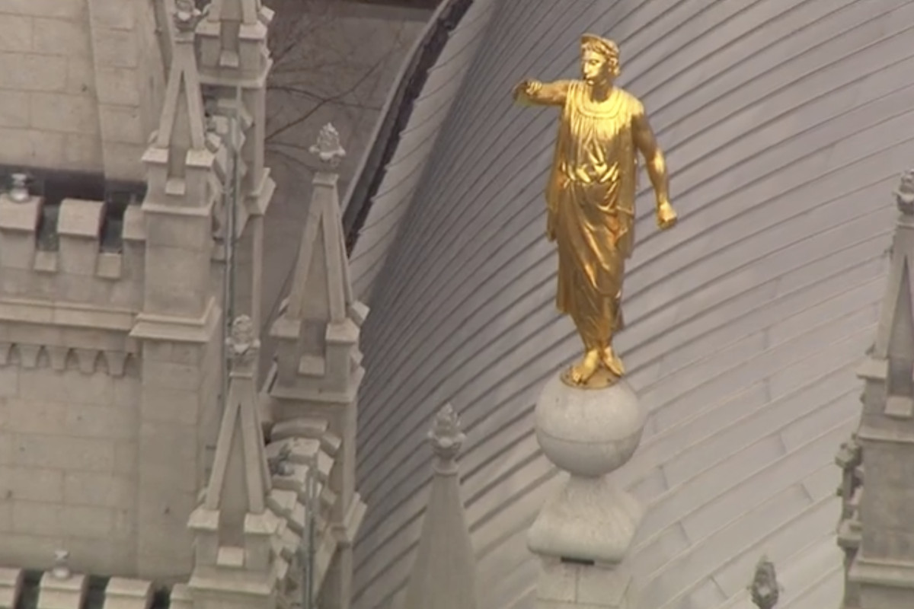
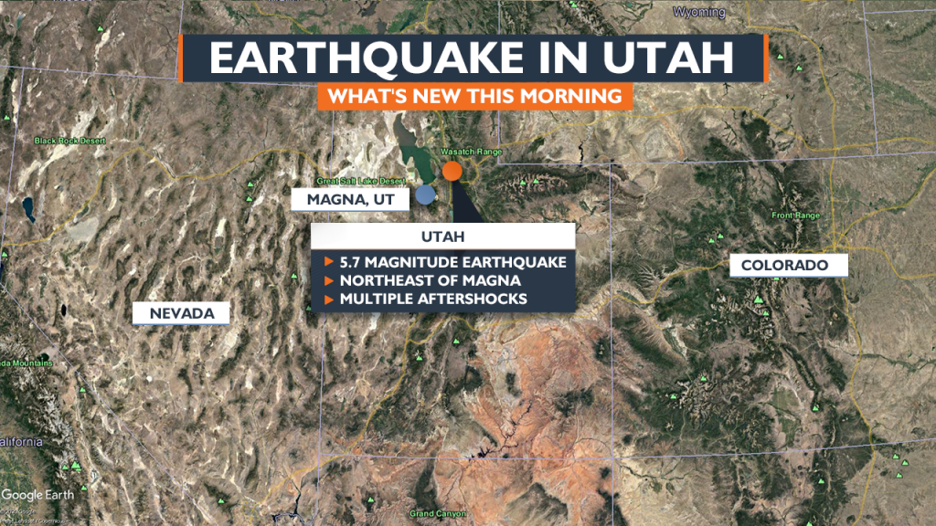

Slide 19
Revelation 8
7 The first angel sounded, and there followed hail and fire mingled with blood, and they were cast upon the earth: and the third part of trees was burnt up, and all green grass was burnt up.

Slide 20
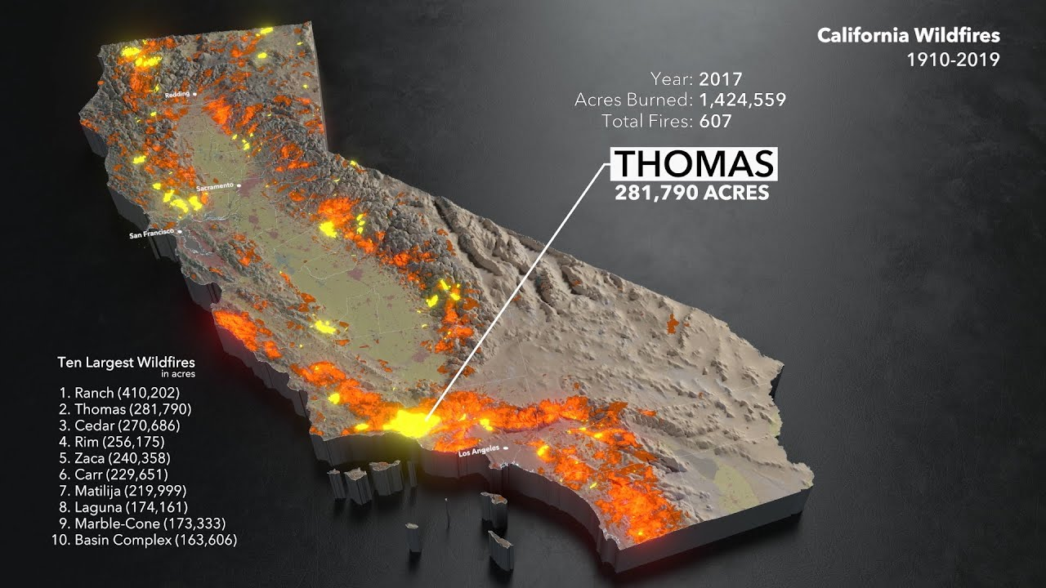
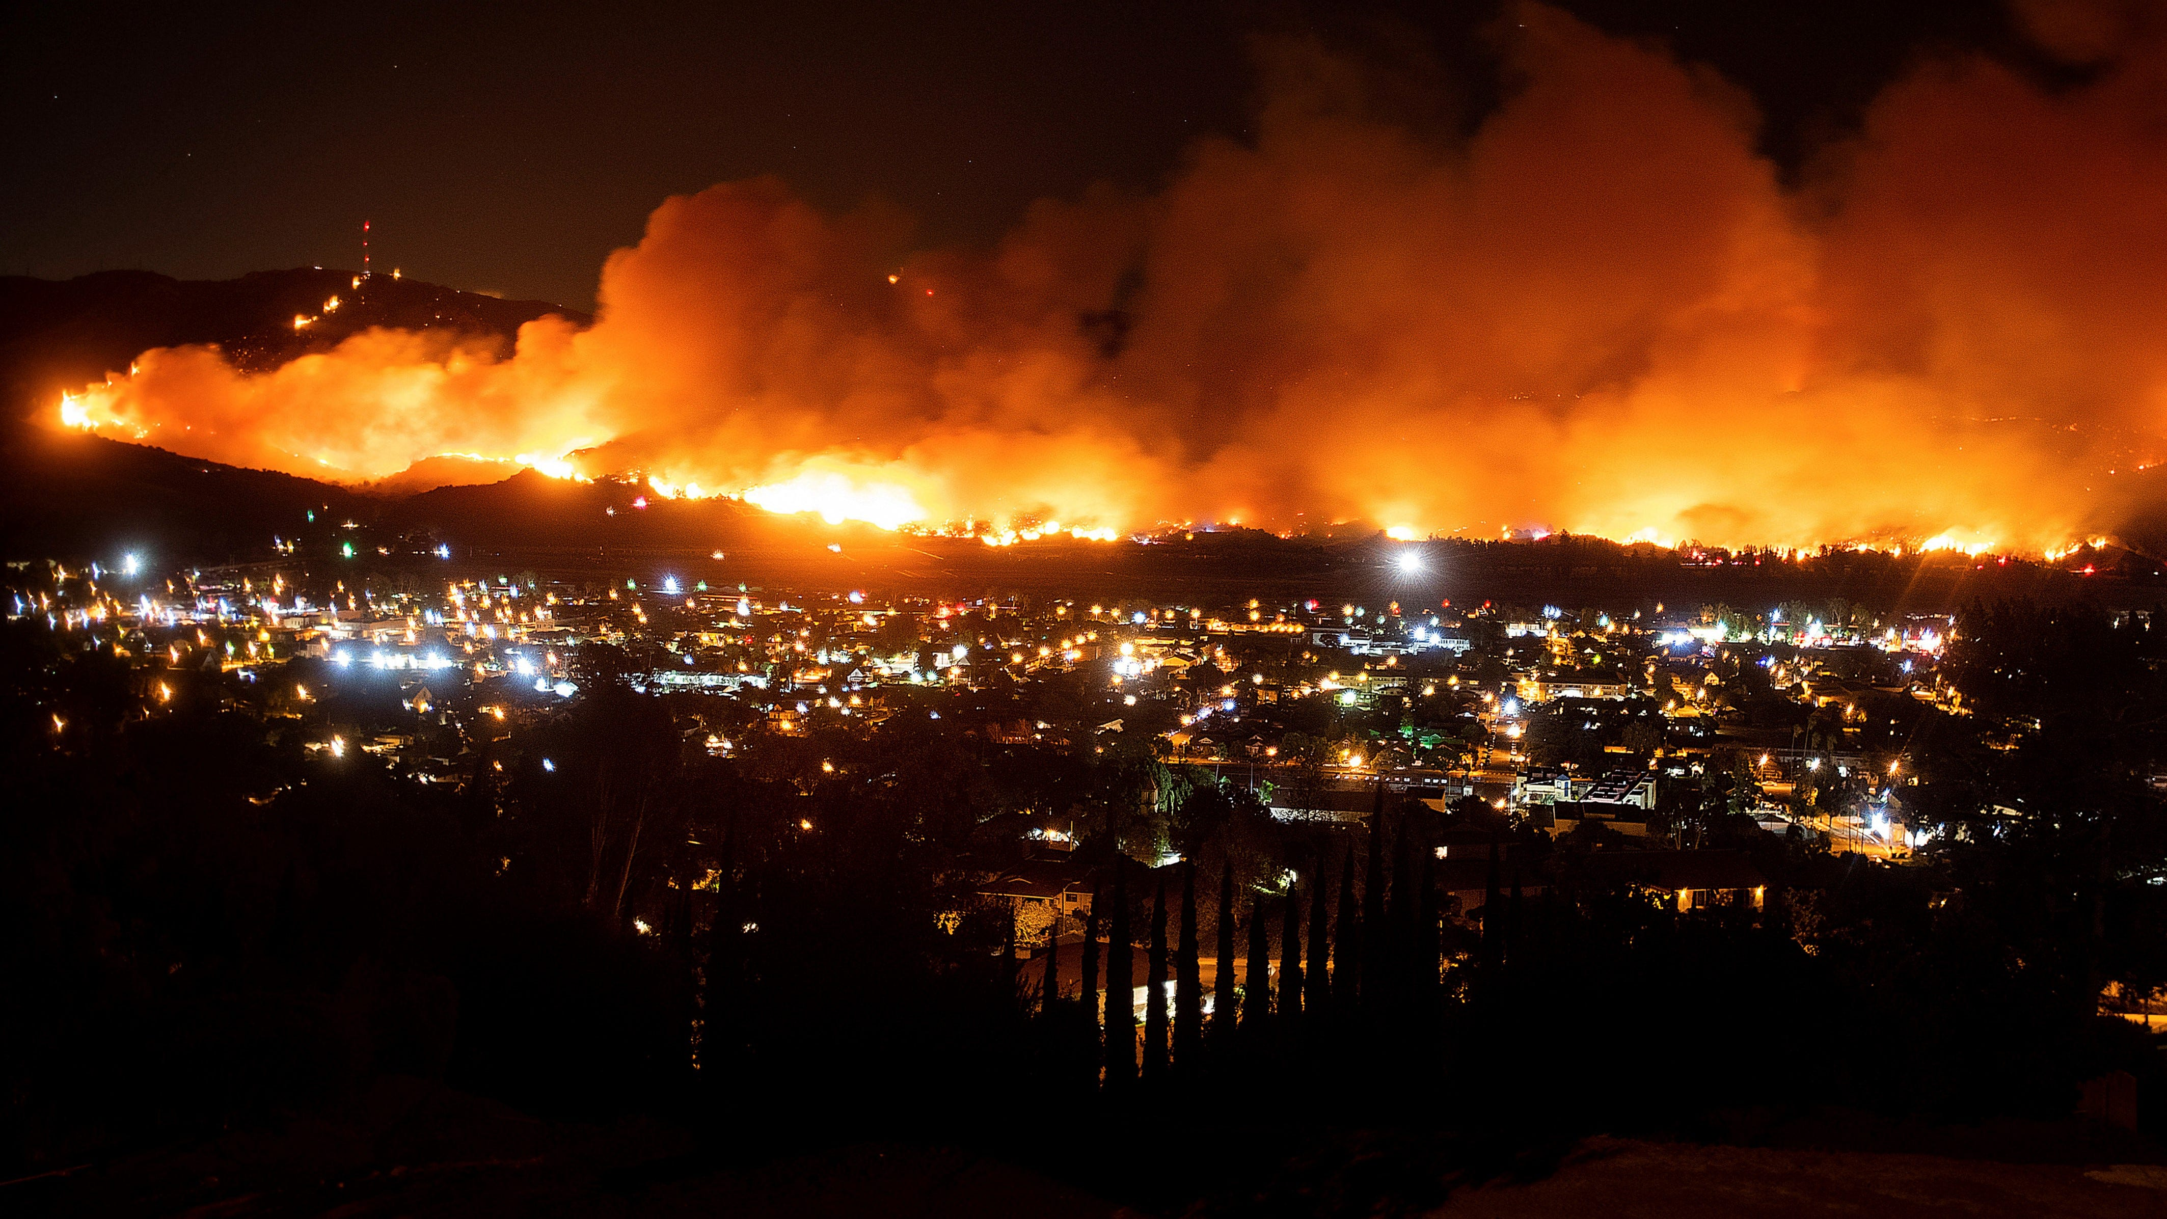

Slide 21
Three groups of people in last days Charles W. Penrose – Millennial Star 1859. Reprinted in Improvement Era March 1924. – Quoted in part in at least 4 CES Institute student manuals
We may consider the inhabitants of the earth at the time immediately preceding the coming of Christ under three general divisions:
First, the saints of God gathered in one place in the western continent, called Zion, busily preparing for his appearance in their midst as their Redeemer, who had shed his blood for their salvation, now coming to reign over them and to reward them for their labors in increasing his government;
Second, the Jews gathered to Jerusalem and also expecting the Messiah, but not believing that Jesus of Nazareth was the Son of God, and being in danger of destruction from their Gentile enemies:
Third, the corrupt nations and kingdoms of men, who, rejecting the light of the Gospel, are unprepared for the Lord’s advent and are almost ripe for destruction.

Slide 22
Group 1 Faithful Saints D&C 133
2 The Lord who shall suddenly come to his temple; the Lord who shall come down upon the world with a curse to judgment; yea, upon all the nations that forget God, and upon all the ungodly among you.
18 When the Lamb shall stand upon Mount Zion, and with him a hundred and forty-four thousand, having his Father’s name written on their foreheads.
19 Wherefore, prepare ye for the coming of the Bridegroom; go ye, go ye out to meet him.

Slide 23
Savior at Zion’s Temple – Charles W. Penrose
Through the preaching of the gospel of Christ as revealed through Joseph Smith-namely, faith, repentance, and baptism for the remission of sins, the laying on of hands for the gift of the Holy Ghost, etc. many among all nations will be led to forsake the traditions of their fathers and become numbered with the people of God. They will gather to one place to prepare themselves for the appearance of the Savior, by learning through his inspired servants the things which are pleasing to him and purifying themselves from all things which he hates. They will build unto him a holy temple. Of necessity some form of government must be set up among them, as they will exist as a national as well as an ecclesiastical capacity. This government will be a theocracy, or, in other words, the Kingdom of God. The laws, ordinances, regulations, etc., will be under the direction of God's Priesthood, and the people will progress in arts, sciences, and everything that will produce happiness, promote union, and establish him in strength, righteousness, and everlasting peace.

Slide 24
Savior at Zion’s Temple
“Among the first-mentioned of these three classes of men [that is, among the Saints in Zion] the Lord will make his appearance first; and that appearance will be unknown to the rest of mankind. He will come to the Temple prepared for him, and his faithful people will behold his face, hear his voice, and gaze upon his glory. From his own lips they will receive further instructions for the development and beautifying of Zion and for the extension and sure stability of his kingdom.

Slide 25
Group 2 To the Jews D&C 133
13 And let them who be of Judah flee unto Jerusalem, unto the mountains of the Lord’s house.
20 For behold, he shall stand upon the mount of Olivet, and upon the mighty ocean, even the great deep, and upon the islands of the sea, and upon the land of Zion.
35 And they also of the tribe of Judah, after their pain, shall be sanctified in holiness before the Lord, to dwell in his presence day and night, forever and ever.

Slide 26
Savior at Jerusalem Temple – Charles W. Penrose
“His next appearance will be among the distressed and nearly vanquished sons of Judah. At the crisis of their fate, when the hostile troops of several nations are ravaging the city and all the horrors of war are overwhelming the people of Jerusalem, he will set his feet upon the Mount of Olives, which will cleave and part asunder at his touch. Attended by a host from heaven, he will overthrow and destroy the combined armies of the Gentiles, and appear to the worshipping Jews as the mighty Deliverer and Conqueror so long expected by their race; and while love, gratitude, awe, and admiration swell their bosoms, the Deliverer will show them the tokens of his crucifixion and disclose himself as Jesus of Nazareth, whom they had reviled and whom their fathers put to death. Then will unbelief part from their souls, and ‘the blindness in part which has happened unto Israel’ be removed. ‘A fountain for sin and uncleanness shall be opened to the house of David and the inhabitants of Jerusalem,’ and ‘a nation will be born’ unto God ‘in a day.’ They will be baptized for the remission of their sins, and will receive the gift of the Holy Ghost, and the government of God as established in Zion will be set up among them, no more to be thrown down for ever.

Slide 27
Group 3 To the world D&C 133
48 And the Lord shall be red in his apparel, and his garments like him that treadeth in the wine-vat.
49 And so great shall be the glory of his presence that the sun shall hide his face in shame, and the moon shall withhold its light, and the stars shall be hurled from their places.
50 And his voice shall be heard: I have trodden the wine-press alone, and have brought judgment upon all people; and none were with me;
51 And I have trampled them in my fury, and I did tread upon them in mine anger, and their blood have I sprinkled upon my garments, and stained all my raiment; for this was the day of vengeance which was in my heart.

Slide 28
Group 3 To the world D&C 133
63 And upon them that hearken not to the voice of the Lord shall be fulfilled that which was written by the prophet Moses, that they should be cut off from among the people.
64 And also that which was written by the prophet Malachi: For, behold, the day cometh that shall burn as an oven, and all the proud, yea, and all that do wickedly, shall be stubble; and the day that cometh shall burn them up, saith the Lord of hosts, that it shall leave them neither root nor branch.
65 Wherefore, this shall be the answer of the Lord unto them:

Slide 29
Group 3 To the world D&C 133
71 Behold, and lo, there are none to deliver you; for ye obeyed not my voice when I called to you out of the heavens; ye believed not my servants, and when they were sent unto you ye received them not.
72 Wherefore, they sealed up the testimony and bound up the law, and ye were delivered over unto darkness.
73 These shall go away into outer darkness, where there is weeping, and wailing, and gnashing of teeth.

Slide 30
Savior to the world– Charles W. Penrose
“Through the rejection of this gospel which "shall be preached to all the world as a witness" of the coming of Christ, the world will increase in confusion, doubt, and horrible strife. As the upright in heart, the meek of the earth, withdraw from their midst, so will the Spirit of God also be withdrawn from them. The darkness upon their minds in relation to eternal things will become blacker, nations will engage in frightful and bloody warfare, the crimes which are now becoming so frequent will be of continual occurrence, the ties that bind together families and kindred will be disregarded and violated, the passions of human nature will be put to the vilest uses, the very elements around will seem to be affected by the national and social convulsions that will agitate the world, and storms, earthquakes, and appalling disasters by sea and land will cause terror and dismay among the people; new diseases will silently eat their ghastly way through the ranks of the wicked; the earth soaked with gore and defiled with the filthiness of his inhabitants, will begin to withhold her fruits in their season; the waves of the sea will heave themselves beyond their bounds, and all things will be in commotion; and in the midst of all these calamities, the master-minds among nations will be taken away, and fear will take hold of the hearts of all men.

Slide 31
Savior to the world– Charles W. Penrose
O ye children of men, put away your sins — repent of your evil doings. The Spirit of the Lord has whispered in your hearts, and you have felt your iniquities, when alone in the silent night you have been sleepless. Heed not the gibe and the sneer of the corrupt and evil-minded, but come forth and be buried with Christ in baptism; receive the rich gift of the Spirit of God, and help, with the Saints, to prepare the kingdom for the Son of Man, that when he shall come you may be looking for his appearance, and that the "day of the Lord" may not come upon you unawares, "like a thief in the night.

Slide 32
What should we do? D&C 133
16 Hearken and hear, O ye inhabitants of the earth. Listen, ye elders of my church together, and hear the voice of the Lord; for he calleth upon all men, and he commandeth all men everywhere to repent.
President Nelson - we can “feel enduring peace and joy, even during turbulent times,” as we strive to become more like our Savior, Jesus Christ. We should “repent daily” to receive the Lord’s “cleansing, healing, and strengthening power.”

Slide 33
What should we do? D&C 133
14 Go ye out from among the nations, even from Babylon, from the midst of wickedness, which is spiritual Babylon.
15 But verily, thus saith the Lord, let not your flight be in haste, but let all things be prepared before you; and he that goeth, let him not look back lest sudden destruction shall come upon him.

Slide 34
What should we do? President Nelson
“My first invitation to you today is to disengage from a constant reliance on social media…President Nelson shared the story of a young man who had to give up his smartphone for a bit. At first, he panicked. (Can you relate?) But then, he was grateful. He felt “free for the first time in a long time” and loved being “free from the fake life that social media creates” and had much more time and energy to be outside, serve others, listen in church, and prepare for his mission. And he was so much happier. Social media can certainly be a wonderful tool to connect with others and share goodness, but if you’re paying more attention to your Instagram feed or favorite YouTube videos than to the Spirit, it’s a problem. “[The] downside of social media is that it creates a false reality,” “Everyone posts their most fun, adventurous, and exciting pictures, which create the erroneous impression that everyone except you is leading a fun, adventurous, and exciting life. Much of what appears in your various social media feeds is distorted, if not fake.” So what should you do? Give yourself a…break from fake!

Slide 35
What should we do? President Nelson
President Russell M. Nelson wrapped up his nine-day, seven-nation tour of the Pacific with a warning to…Latter-day Saints to beware of evil. “There’s trouble ahead … prepare for attacks from the adversary….“Please protect yourself from Satan's traps, including harmful drugs and pornography.”

Slide 36
What should we do? D&C 133
8 Send forth the elders of my church unto the nations which are afar off; unto the islands of the sea; send forth unto foreign lands; call upon all nations, first upon the Gentiles, and then upon the Jews.
9 And behold, and lo, this shall be their cry, and the voice of the Lord unto all people: Go ye forth unto the land of Zion, that the borders of my people may be enlarged, and that her stakes may be strengthened, and that Zion may go forth unto the regions round about.
10 Yea, let the cry go forth among all people: Awake and arise and go forth to meet the Bridegroom; behold and lo, the Bridegroom cometh; go ye out to meet him. Prepare yourselves for the great day of the Lord.

Slide 37
What should we do? President Nelson
“Anytime you do anything that helps anyone—on either side of the veil—take a step toward making covenants with God and receiving their essential baptismal and temple ordinances, you are helping to gather Israel. It is as simple as that”
Make a weekly sacrifice of time to the Lord.
Keep on the covenant path.
Pray daily that all of God’s children might receive the blessings of the gospel of Jesus Christ.
Stand out and be different from the world. Be a light.
(Russell M. Nelson, “Hope of Israel,” worldwide devotional for youth, June 3, 2018, churchofjesuschrist.org/broadcasts).

Slide 38
What should we do? President Nelson
Participate in family history work.
Do baptisms for the dead.
Share the gospel and your standards.
Prepare to make covenants in the temple.
Faithfully support friends and family who are struggling.
Serve and help others who are striving to do temple and family history work.
“Learn for yourself—right now at your age—how to receive personal revelation. And nothing will make a bigger difference in your life than that!.

Slide 39
What should we do? President Nelson
The decision to serve a mission will shape the spiritual destiny of the missionary, his or her spouse, and their posterity for generations to come,” “A desire to serve is a natural outcome of one's conversion, worthiness and preparation.
"The Lord needs selfless men who put the welfare of others ahead of their own,”…"The Lord needs men eager to repent — men with a zeal to serve and be part of the Lord’s battalion of worthy priesthood bearers."
https://www.churchofjesuschrist.org/church/news/elder-nelson-explains-the-importance-of-missionary-work?lang=eng

Slide 40
What should we do? President Nelson
My dear extraordinary youth, you were sent to earth at this precise time, the most crucial time in the history of the world, to help gather Israel. There is nothing happening on this earth right now that is more important than that. There is nothing of greater consequence. Absolutely nothing....So, now I am inviting every young woman and every young man between the ages of 12 and 18 in The Church of Jesus Christ of Latter-day Saints to enlist in the youth battalion of the Lord to help gather Israel.—President Russell M. Nelson, "Hope of Israel, June 3, 2018.

