Slide 1
Noah and the Ark

Slide 2
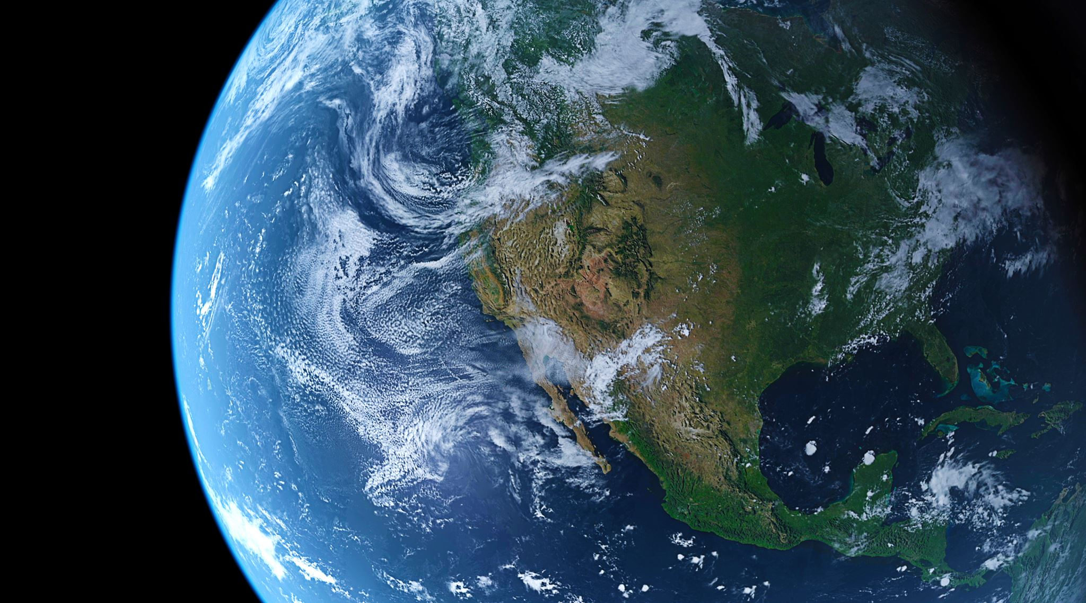
Where does Noah fit in the timeline of earth’s history?

Slide 3
Adam left the Garden of Eden approximately 4000 B.C.
(New Testament Institute Student manual - Revelation 6, Old Testament Bookmarks)
Adam was 130 when Seth was born – (Moses 6:10)
Adam was 235 when Enos was born – (Moses 6:13)
Adam was 325 when Cainen was born – (Moses 6:17)
Adam was 395 when Mahaleel was born – (Moses 6:19)
Adam was 460 when Jared was born – (Moses 6:20)
Adam was 622 when Enoch was born in the year 3378 – (Moses 6:21)
Adam was 687 when he blessed Enoch at the age of 65. Enoch received priesthood at 25 from Adam (D&C 107:48)
Adam was 687 when Methusaleh was born to Enoch at the age 65 – (Moses 6:25)
Adam was 874 when Lamech was born. (Moses 8:5)
Adam died when he was 930 years old appx in the year 3070 (Moses 6:11)
Enoch was translated appx in the year 2948 – 1052 years since the fall. (Moses 8:1)
Noah was born 126 years after Adam died and knew Enos, Cainen, Mahaleel, Jared, Methusaleh, Lamech. Born in the year 2944 (Moses 8:8)

Slide 4
Noah was born 126 years after Adam died and knew Enos, Cainen, Mahaleel, Jared, Methusaleh, Lamech. (2944)
Methusaleh died in the same year the flood began. (Year 2344 – Moses 8:7)
Lamech died five years earlier. (Year 2349 - Moses 8:10-11)
Noah was ordained to the priesthood at age 10 by Methuselah. (D&C 107:52)
Noah was 450 when Japheth was born – (Year 2494 – Moses 8:12)
Noah was 492 when Shem was born – (Year 2452 – Moses 8:12)
Noah was 500 when Ham was born – (Year 2444 – Moses 8:12)
In the year 2464 Noah receives a prophecy that God will come and destroy the earth in 120 years. (Moses 8:17)
In the year 2344 Flood comes – 2nd month 17th Day (Genesis 6:11)
In the year 2343 On the water for almost one year. 1st month 1st day (Genesis 8:13)
In the year 2343 Left ark on 2nd month 27th day Noah leaves the ark (Genesis 8:14)
Noah dies approx. in the year 1994 B.C. after living 950 years
Abraham born approx. in the year 2000 B.C.

Slide 5
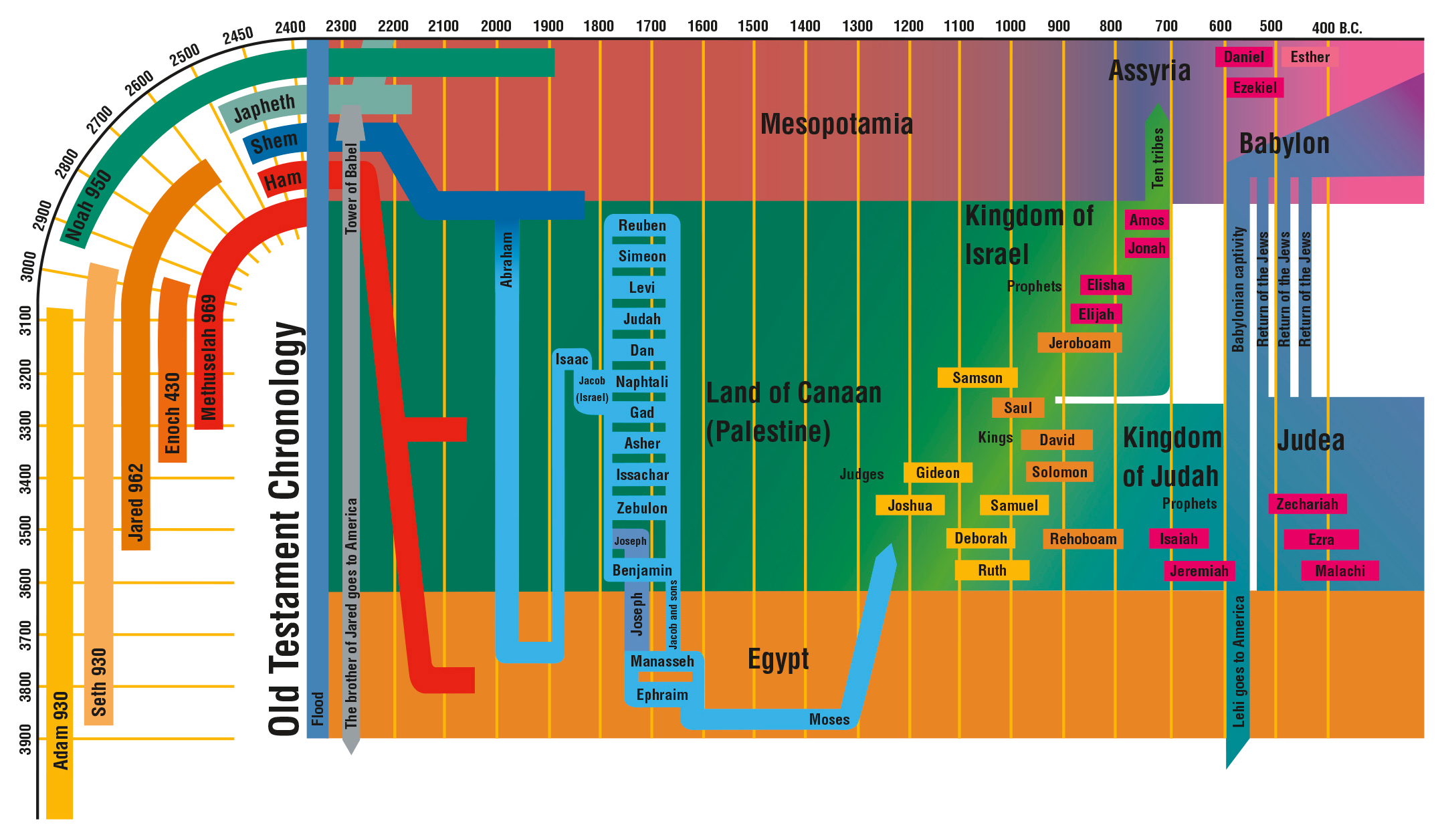

Slide 6
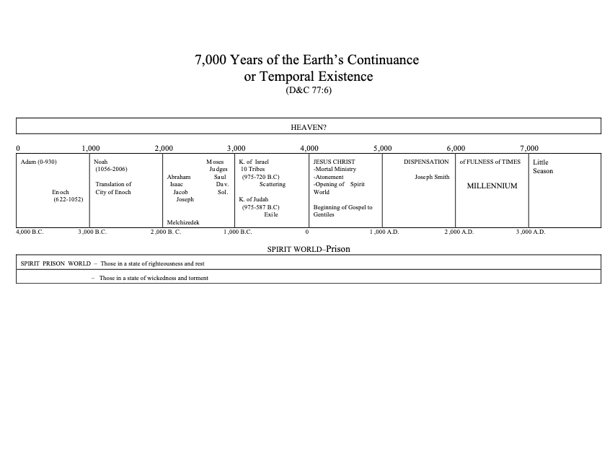

Slide 7
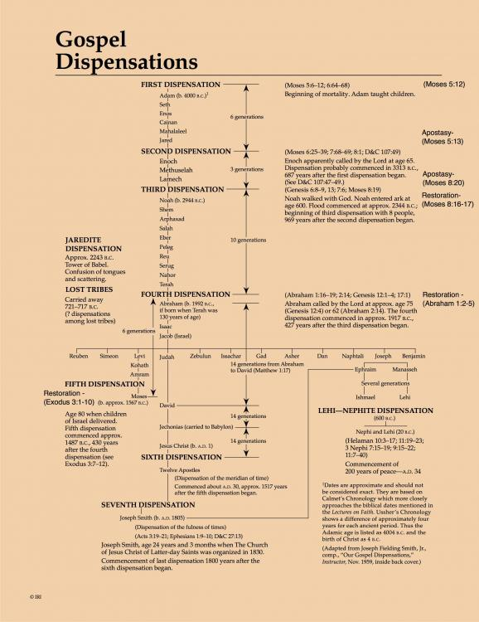

Slide 9
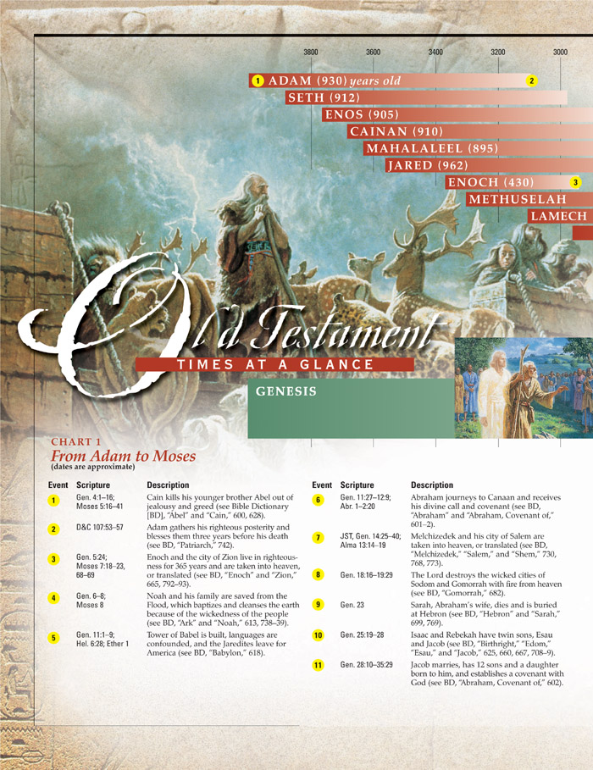
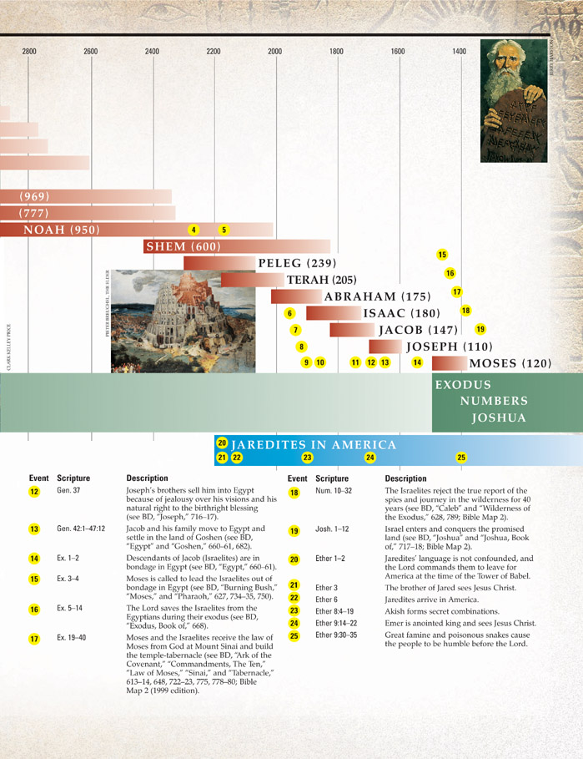

Slide 10
Did Methuselah Die in the Flood?
A careful examination of the record of the patriarchs in this section of Genesis shows that Methuselah died in the year of the Flood. Some have wondered why he was not taken on the ark with Noah and have concluded that he may have been wicked. The book of Moses, however, shows that the lineage given in this part of the record traces the righteous patriarchal line (see Moses 6:23), and Methuselah was in that line. Moses 8:3 records that Methuselah was not taken with the city of Enoch so that the line could be continued. Also, Methuselah prophesied that through his own seed would spring all nations of the earth (through the righteous Noah). Clearly, he too was righteous. Then is added this sentence: “And he took glory unto himself” (Moses 8:3). Once his work was done he may have been translated too, for during the nearly seven hundred years from the time the city of Enoch was translated until the time of the Flood the righteous Saints were translated and joined Enoch’s people
(Old Testament Institute Student Manual Genesis 4-11; see Moses 7:27; see also McConkie, Mormon Doctrine, p. 804).

Slide 11
Did Methuselah Die in the Flood?
Although most scholars believe Methuselah’s name means “man of the javelin” or “man of the spear,” one scholar wrote the following interpretation that, if correct, would make Methuselah’s name a prophetic one:
“Methuselah lived till the very year in which the flood came, of which his name is supposed to have been prophetical … methu, ‘he dieth,’ and shalach, ‘he sendeth out’; as if God had designed to teach men that as soon as Methuselah died the flood should be sent forth to drown an ungodly world. If this were then so understood, even the name of this patriarch contained in it a gracious warning.”
(Old Testament Institute Student Manual Genesis 4-11; Clarke, Bible Commentary, 1:68.)

Slide 12
Why is Noah chosen to build the ark and restart humanity?

Slide 13
Many generations of prophets foresaw Noah as the prophet in the days of the cleansing of the earth by flood (see Moses 8:2, 9). Noah was ordained to the higher priesthood when ten years old by his grandfather Methuselah (see D&C 107:52). He became a preacher of righteousness, even as Enoch. He, his wife, and his sons—Japheth, Shem, and Ham﻿—and their wives were the only people to survive the Flood. Noah holds the keys of his dispensation and stands next to Adam in authority
(PGPISM Moses 8;see Teachings of Presidents of the Church: Joseph Smith [2007], 104).

Slide 14
Noah is the angel Gabriel (see Teachings: Joseph Smith, 104), who appeared to Zacharias to announce that he would be the father of John the Baptist and to Mary to announce that she would be the mother of Jesus Christ. Noah also functions in the calling of an Elias (see D&C 27:6–7), meaning one who prepares or restores. Through his various appearances, Noah has performed both of these functions.
(PGPISM Moses 8).

Slide 15
Elder Mark E. Petersen (1900–1984) of the Quorum of the Twelve Apostles wrote: “Noah, who built the ark, was one of God’s greatest servants, chosen before he was born as were others of the prophets. He was no eccentric, as many have supposed. Neither was he a mythical figure created only in legend. Noah was real. …“Let no one downgrade the life and mission of this great prophet. Noah was so near perfect in his day that he literally walked and talked with God. …“Few men in any age were as great as Noah. In many respects he was like Adam, the first man. Both had served as ministering angels in the presence of God even after their mortal experience” Adam was Michael, the archangel, but Noah was Gabriel, one of those nearest to God. Of all the hosts of heaven, he was chosen to open the Christian era by announcing to Mary that she would become the mother of the Savior, Jesus Christ. He even designated the name by which the Redeemer should be known here on earth, saying He would be the Son of God… The Lord decreed that [the earth would be cleansed] by water, a worldwide deluge. Therefore, from among his premortal spirit children, God chose another great individual﻿—His third in line, Gabriel﻿—to resume the propagation of mankind following the flood.”
(OTISM Genesis 4-11; PGPISM Moses 8; Noah and the Flood [1982], 1–2).

Slide 16
Did Noah really teach 120 years and not have one convert?

Slide 17
During the first 2200 or so years of the earth’s history﻿—that is, from the fall of Adam to the ministry of Melchizedek﻿—it was a not uncommon occurrence for faithful members of the Church to be translated and taken into the heavenly realms without tasting death. Since that time there have been occasional special instances of translation, instances in which a special work of the ministry required it.
“… Methuselah, the son of Enoch, was not translated [with Enoch’s city], ‘that the covenants of the Lord might be fulfilled, which he made to Enoch; for he truly covenanted with Enoch that Noah should be of the fruit of his loins.’ (Moses 8:2.) But during the nearly 700 years from the translation of Enoch to the flood of Noah, it would appear that nearly all of the faithful members of the Church were translated, for ‘the Holy Ghost fell on many, and they were caught up by the powers of heaven into Zion.’ (Moses 7:27.)”
(OTISM Genesis 4-11; McConkie, Mormon Doctrine, p. 804.)

Slide 18
What’s the difference between the Children of God and the children of men?

Slide 19
What’s the difference between the Children of God and the children of men?
Moses 6:22-23 Children of God
Moses 6:49-52 children of men

Slide 20
What were the people doing that caused the Lord to wipe them off the face of the earth?

Slide 21
What were the people doing that caused the Lord to wipe them off the face of the earth?
1st great sin – Moses 8:14-16
2nd great sin – Moses 8:18
3rd great sin - Moses 8:22
4th great sin – Moses 8:28

Slide 22
What were the people doing that caused the Lord to wipe them off the face of the earth?
1st great sin – Moses 8:14-16

Slide 23
If you don’t yet love to attend the temple, go more often—not less. Let the Lord, through His Spirit, teach and inspire you there. I promise you that over time, the temple will become a place of safety, solace, and revelation.
If it were possible for me to speak one-on-one with every young adult, I would plead with you to seek a companion with whom you can be sealed in the temple. You may wonder what difference this will make in your life. I promise it will make all the difference! As you marry in the temple and return repeatedly, you will be strengthened and guided in your decisions.
If I could speak with each husband and wife who have still not been sealed in the temple, I would plead with you to take the necessary steps to receive that crowning, life-changing ordinance. Will it make a difference? Only if you want to progress forever and be together forever. Wishing to be together forever will not make it so. No other ceremony or contract will make it so.
If I could speak to each man or woman who longs for marriage but has not yet found his or her eternal companion, I would urge you not to wait until marriage to be endowed in the house of the Lord. Begin now to learn and experience what it means to be armed with priesthood power.
(President Russell M. Nelson CR Oct 2021)

Slide 24
President Joseph Fielding Smith (1876–1972) applied the lessons from Moses 8:14–15 to our day, saying: “Because the daughters of Noah married the sons of men contrary to the teachings of the Lord, his anger was kindled, and this offense was one cause that brought to pass the universal flood. … The daughters who had been born, evidently under the covenant, and were the daughters of the sons of God, that is to say of those who held the priesthood, were transgressing the commandment of the Lord and were marrying out of the Church. Thus they were cutting themselves off from the blessings of the priesthood contrary to the teachings of Noah and the will of God. …
“Today there are foolish daughters of those who hold this same priesthood who are violating this commandment and marrying the sons of men; there are also some of the sons of those who hold the priesthood who are marrying the daughters of men. All of this is contrary to the will of God just as much as it was in the days of Noah”
(PGPISM Moses 8; Answers to Gospel Questions, comp. Joseph Fielding Smith Jr. [1957], 1:136–37).

Slide 25
What were the people doing that caused the Lord to wipe them off the face of the earth?
2nd great sin – Moses 8:18
3rd great sin - Moses 8:22
4th great sin – Moses 8:28

Slide 26
How can a just and loving God destroy his children and still be merciful and kind?

Slide 27
President John Taylor (1808–87) taught: “God destroyed the wicked of that generation with a flood. Why did He destroy them? He destroyed them for their benefit, if you can comprehend it”
(“Discourse,” Deseret News, Nov. 7, 1883, 658; see also “Discourse,” Deseret News, Jan. 16, 1878, 787, for President Taylor’s view of the Flood as an act of love).

Slide 28
Elder Neal A. Maxwell of the Quorum of the Twelve Apostles explained that God intervened “when corruption had reached an agency-destroying point that spirits could not, in justice, be sent here” (OTSTM Moses 8; Neal A. Maxwell, We Will Prove Them Herewith [1982], 58).
President John Taylor explained that “by taking away their earthly existence [God] prevented them from entailing their sins upon their posterity and degenerating [or corrupting] them, and also prevented them from committing further acts of wickedness”
(OTSTM Moses 8; John Taylor, “Discourse Delivered by Prest. John Taylor,” Deseret News, Jan. 16, 1878, 787).

Slide 29
“Now I will go back to show you how the Lord operates. He destroyed a whole world at one time save a few, whom he preserved for his own special purpose. And why? He had more than one reason for doing so. This antediluvian people were not only very wicked themselves, but having the power to propagate their species, they transmitted their unrighteous natures and desires to their children, and brought them up to indulge in their own wicked practices. And the spirits that dwelt in the eternal worlds knew this, and they knew very well that to be born of such parentage would entail upon themselves an infinite amount of trouble, misery and sin. And supposing ourselves to be of the number of unborn spirits, would it not be fair to presume that we would appeal to the Lord, crying, ‘Father, do you not behold the condition of this people, how corrupt and wicked they are?’ ‘Yes.’ ‘Is it then just that we who are now pure should take of such bodies and thus subject ourselves to most bitter experiences before we can be redeemed, according to the plan of salvation?’ ‘No,’ the Father would say, ‘it is not in keeping with my justice.’ ‘Well, what will you do in the matter; man has his free agency and cannot be coerced, and while he lives he has the power of perpetuating his species?’ ‘I will first send them my word, offering them deliverance from sin, and warning them of my justice, which shall certainly overtake them if they reject it, and I will destroy them from off the face of the earth, thus preventing their increase, and I will raise up another seed.’ Well, they did reject the preaching of Noah, the servant of God, who was sent to them, and consequently the Lord caused the rains of heaven to descend incessantly for forty days and nights, which flooded the land, and there being no means of escape, save for the eight souls who were obedient to the message, all the others were drowned. But, says the caviller, is it right that a just God should sweep off so many people? Is that in accordance with mercy? Yes, it was just to those spirits that had not received their bodies, and it was just and merciful too to those people guilty of the iniquity. Why? Because by taking away their earthly existence he prevented them from entailing their sins upon their posterity and degenerating them, and also prevented them from committing further acts of wickedness.”
(OTISM Gen 4-11; John Taylor, in Journal of Discourses, 19:158–59.)

Slide 30
What is our ark?

Slide 31
In our own time, we have been warned with counsel of where to find safety from sin and from sorrow. One of the keys to recognizing those warnings is that they are repeated. For instance, more than once in these general conferences, you have heard our prophet say that he would quote a preceding prophet and would therefore be a second witness and sometimes even a third. Each of us who has listened has heard President Kimball give counsel on the importance of a mother in the home and then heard President Benson quote him, and we have heard President Hinckley quote them both. The Apostle Paul wrote that “in the mouth of two or three witnesses shall every word be established” (2 Cor. 13:1). One of the ways we may know that the warning is from the Lord is that the law of witnesses, authorized witnesses, has been invoked. When the words of prophets seem repetitive, that should rivet our attention and fill our hearts with gratitude to live in such a blessed time.

Slide 32
Looking for the path to safety in the counsel of prophets makes sense to those with strong faith. When a prophet speaks, those with little faith may think that they hear only a wise man giving good advice. Then if his counsel seems comfortable and reasonable, squaring with what they want to do, they take it. If it does not, they consider it either faulty advice or they see their circumstances as justifying their being an exception to the counsel. Those without faith may think that they hear only men seeking to exert influence for some selfish motive. They may mock and deride…

Slide 33
Another fallacy is to believe that the choice to accept or not accept the counsel of prophets is no more than deciding whether to accept good advice and gain its benefits or to stay where we are. But the choice not to take prophetic counsel changes the very ground upon which we stand. It becomes more dangerous. The failure to take prophetic counsel lessens our power to take inspired counsel in the future. The best time to have decided to help Noah build the ark was the first time he asked. Each time he asked after that, each failure to respond would have lessened sensitivity to the Spirit. And so each time his request would have seemed more foolish, until the rain came. And then it was too late.

Slide 34
Every time in my life when I have chosen to delay following inspired counsel or decided that I was an exception, I came to know that I had put myself in harm’s way. Every time that I have listened to the counsel of prophets, felt it confirmed in prayer, and then followed it, I have found that I moved toward safety. Along the path, I have found that the way had been prepared for me and the rough places made smooth. God led me to safety along a path which was prepared with loving care, sometimes prepared long before.
(Henry B. Eyring Finding Safety in Counsel CR April 1997)

Slide 35
The revelation to produce and store food may be as essential to our temporal welfare today as boarding the ark was to the people in the days of Noah.
Too often we bask in our comfortable complacency and rationalize that the ravages of war, economic disaster, famine, and earthquake cannot happen here. Those who believe this are either not acquainted with the revelations of the Lord, or they do not believe them. Those who smugly think these calamities will not happen, that they somehow will be set aside because of the righteousness of the Saints, are deceived and will rue the day they harbored such a delusion. (TPOTC Ezra Taft Benson Chpt 21)

Slide 36
The temple lies at the center of strengthening our faith and spiritual fortitude because the Savior and His doctrine are the very heart of the temple. Everything taught in the temple, through instruction and through the Spirit, increases our understanding of Jesus Christ. His essential ordinances bind us to Him through sacred priesthood covenants. Then, as we keep our covenants, He endows us with His healing, strengthening power. And oh, how we will need His power in the days ahead.
We have been promised that “if [we] are prepared [we] shall not fear.” This assurance has profound implications today. The Lord has declared that despite today’s unprecedented challenges, those who build their foundations upon Jesus Christ, and have learned how to draw upon His power, need not succumb to the unique anxieties of this era.
(Russell M. Nelson CR Oct 2021)

Slide 37
Temple ordinances and covenants are ancient. The Lord instructed Adam and Eve to pray, make covenants, and offer sacrifices. Indeed, “whenever the Lord has had a people on the earth who will obey His word, they have been commanded to build temples.” The standard works are replete with references to temple teachings, clothing, language, and more. Everything we believe and every promise God has made to His covenant people come together in the temple. In every age, the temple has underscored the precious truth that those who make covenants with God and keep them are children of the covenant.
Thus, in the house of the Lord, we can make the same covenants with God that Abraham, Isaac, and Jacob made. And we can receive the same blessings!
(Russell M. Nelson CR Oct 2021)

Slide 38
What should we do differently?

